Slide 1
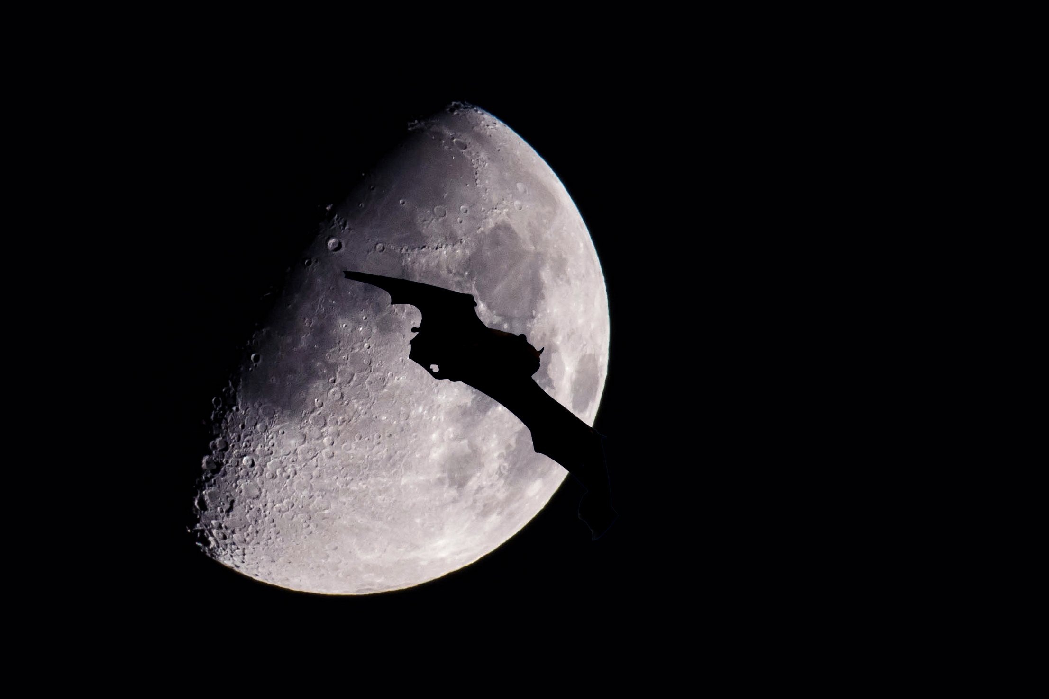
Sculthorpe Moor
Intermediate Nature Photography Course with Steve Norris

Slide 2
Your Host
Steve Norris
I joined Press Association Photos in Fleet Street in 1967 as a Trainee Press Photographer but had a change of direction and continued my training with various London Studios. I became assistant to a world renowned society and editorial photographer, Tessa Traeger, and worked with her in Rossetti Studios in Flood Street, Chelsea until becoming a professional in my own right.
For various reasons (mostly having to pay tax bills) I became involved in the motor trade for the next 35 years but returned to my old profession 7 years ago. My work is mainly portrait and website photography but my enjoyment of nature and the outdoors has led me to running wildlife courses and ‘one to one’ tutorials.
Now you have all READ YOUR MANUALS there will be a few less slides in this presentation than the beginners course, but we will be covering some slightly more challenging subjects that should help you to take even better images than you do now.
I hope you enjoy the day with me and please feel free to ask questions at any time.

Slide 3
Birds, Backgrounds & Props
Hone your skills in your garden!

Slide 4
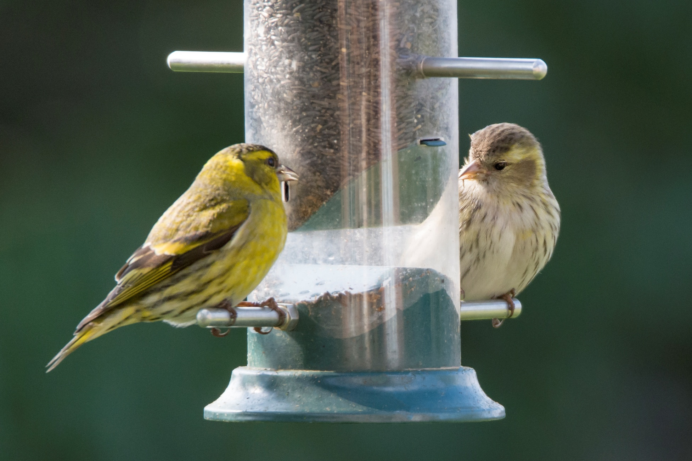
D7200 f.6.3 1/500 sec ISO 800 600mm - 0.7 EC

Slide 5
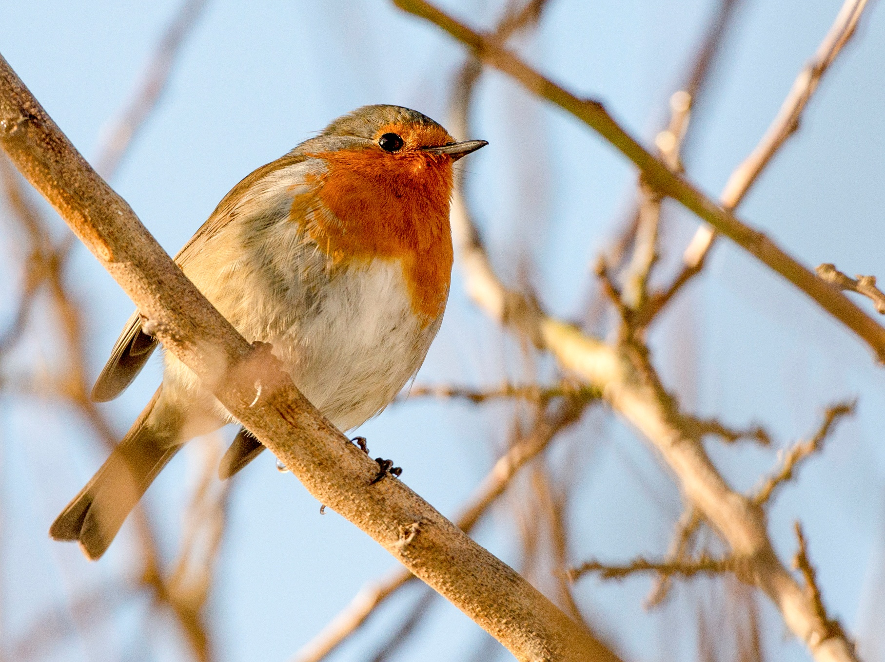
D600 f.5.6 1/1600 sec ISO 1000 200mm - 1 EC

Slide 6
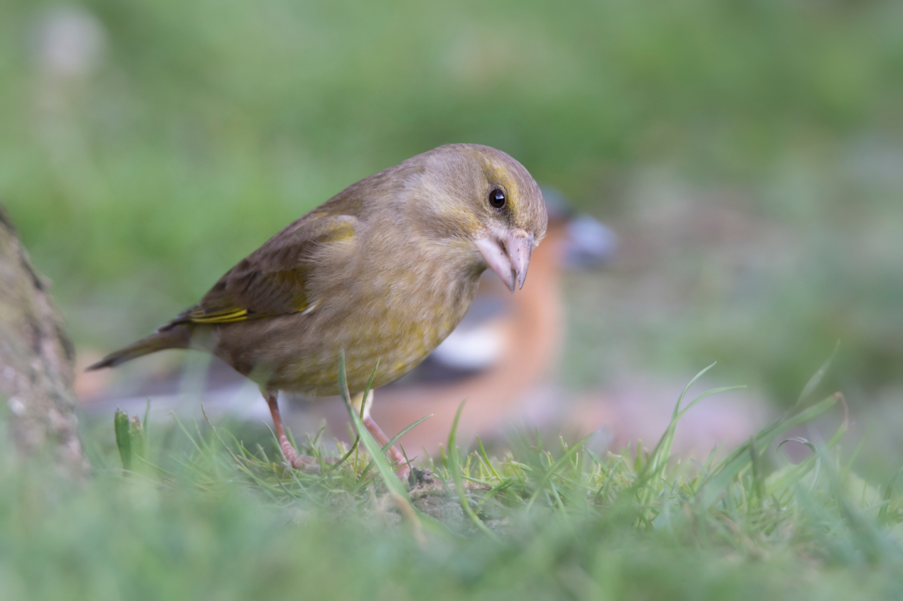
D7200 f.6.3 1/200 sec ISO 800 600mm No EC

Slide 7
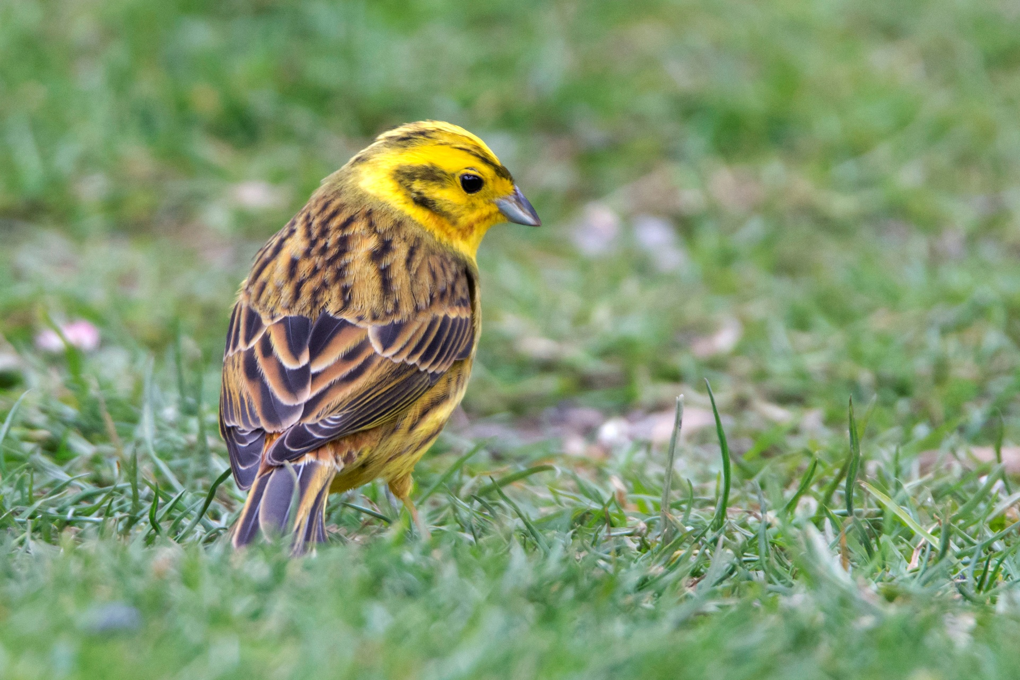
D7200 f.6.3 1/320 sec ISO 1250 600mm No EC

Slide 8
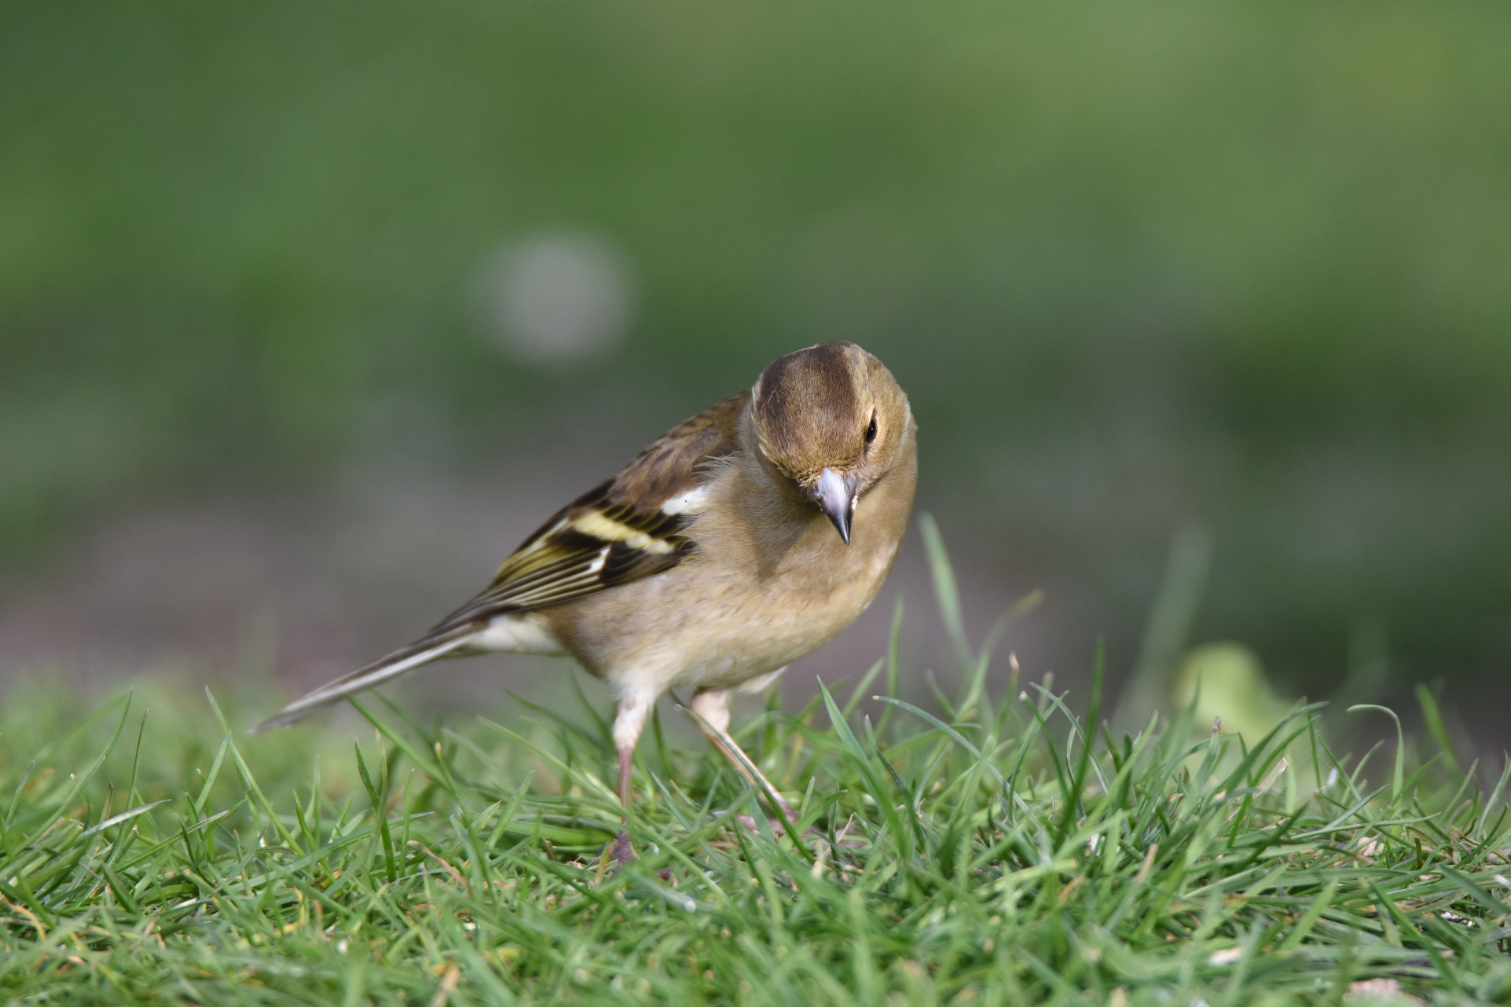
D7200 f.7.1 1/250 sec ISO 400 600mm - 0.3 EC

Slide 9
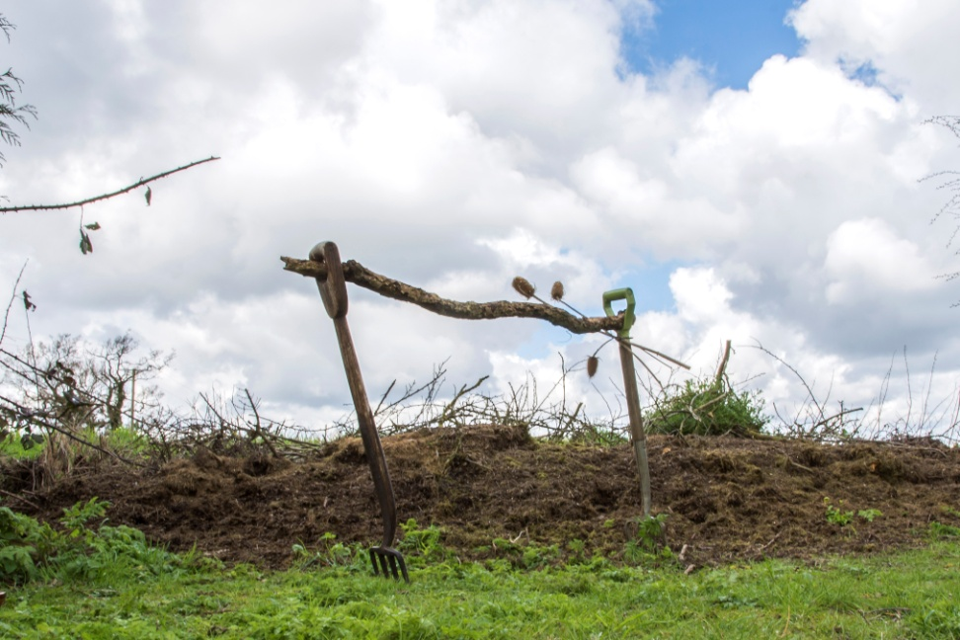
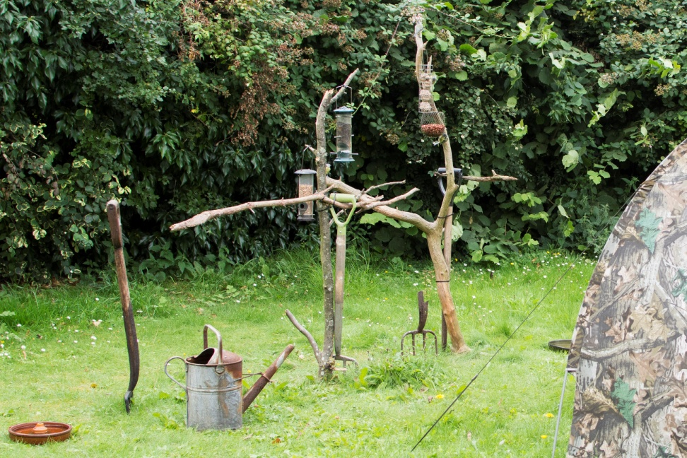
A Simple Garden Photo Set

Slide 10
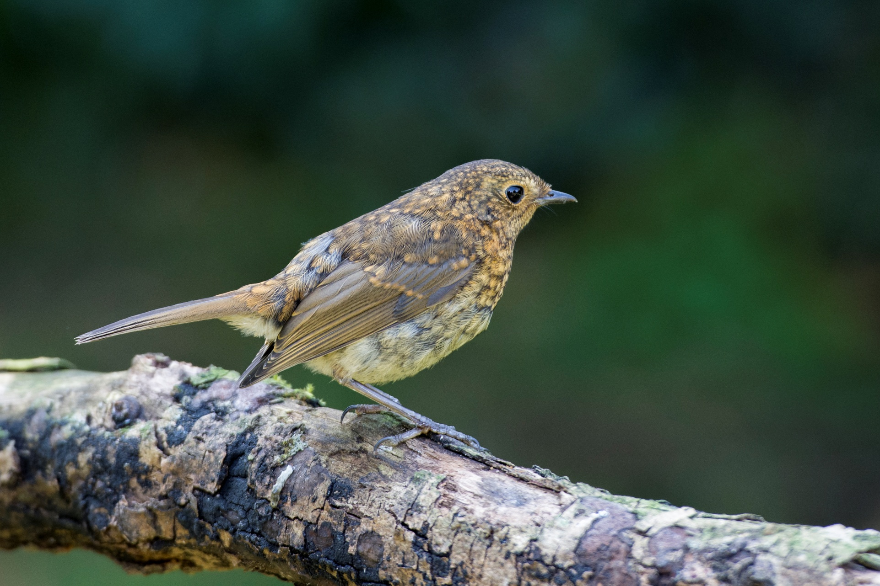
D7200 f.3.5 1/320 sec ISO 640 200mm No EC

Slide 11
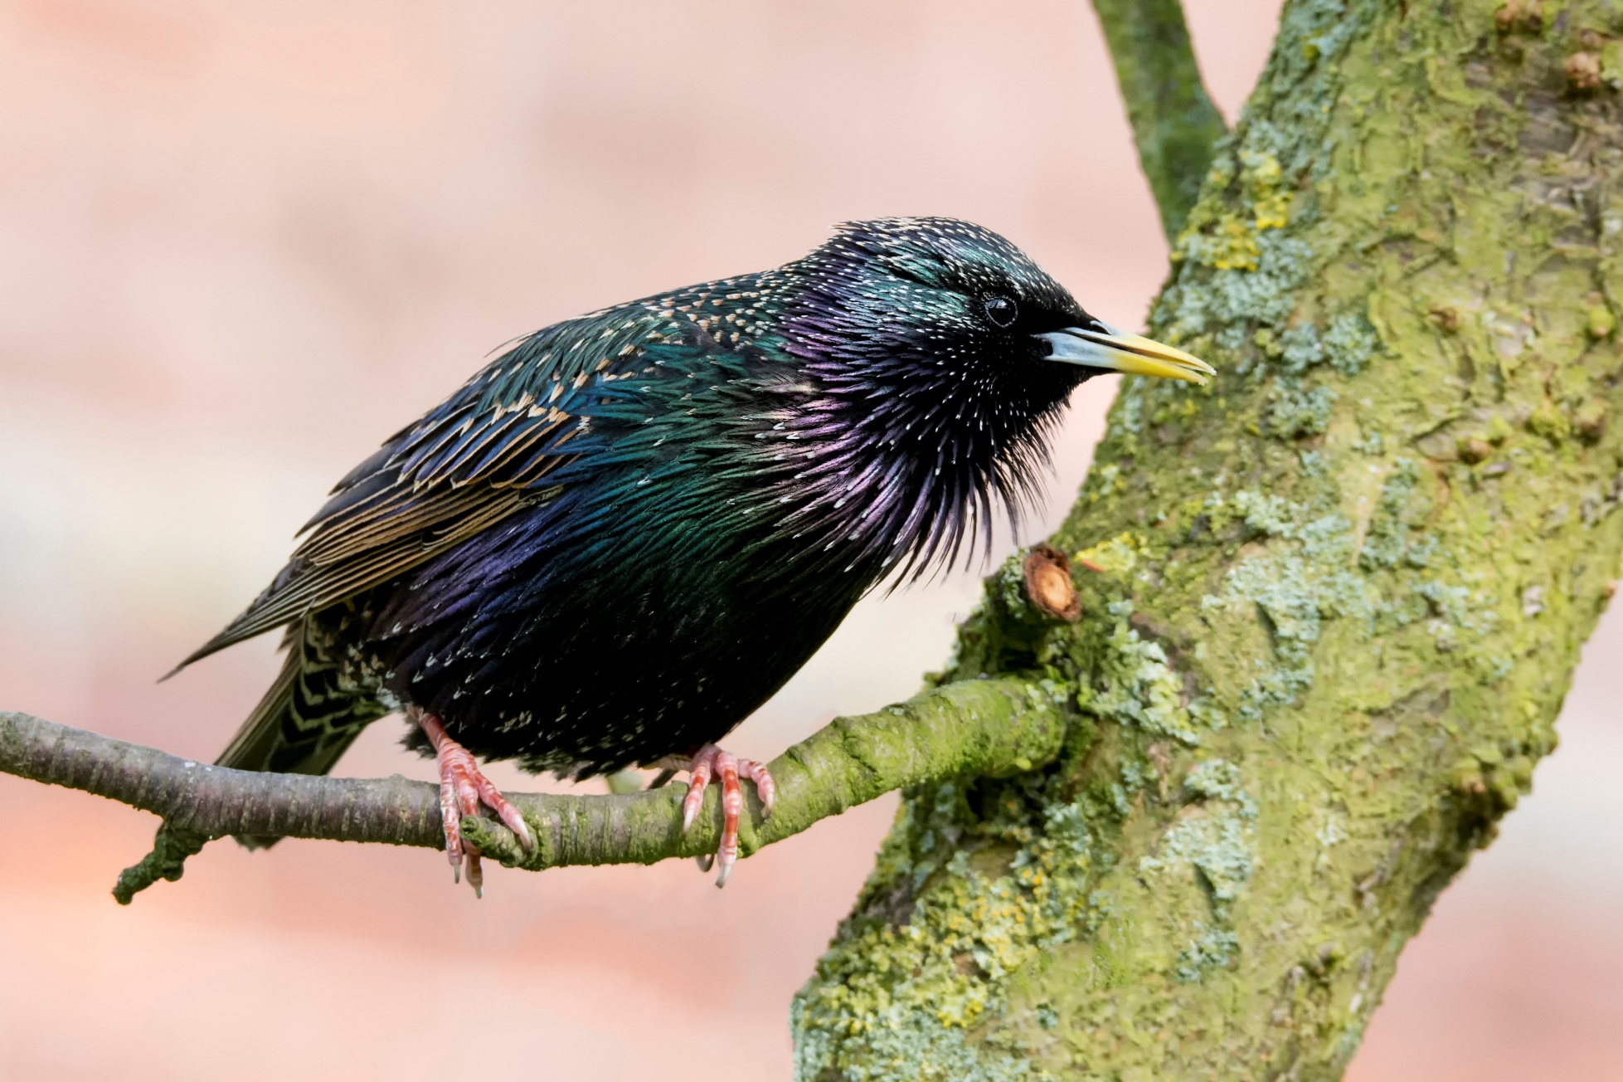
D7200 f.8 1/320 sec ISO 1000 330mm - 0.7 EC

Slide 12
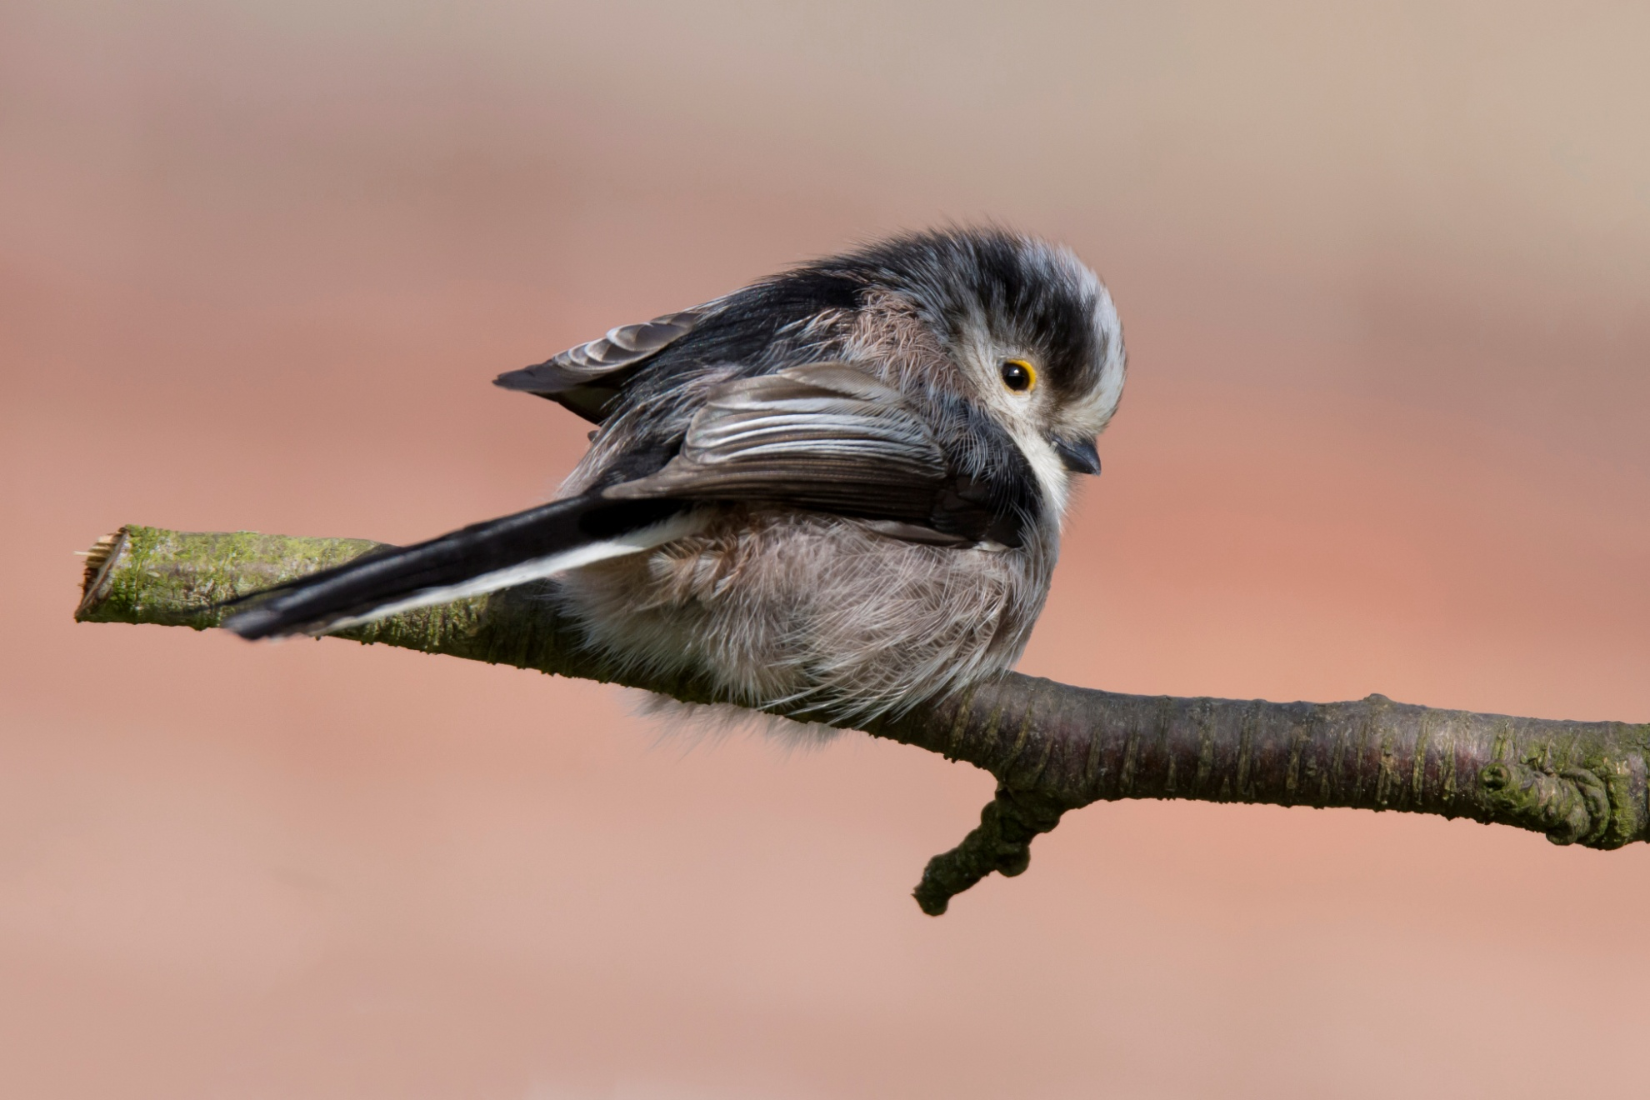
D7200 f.8 1/640sec ISO 640 600mm No EC

Slide 13
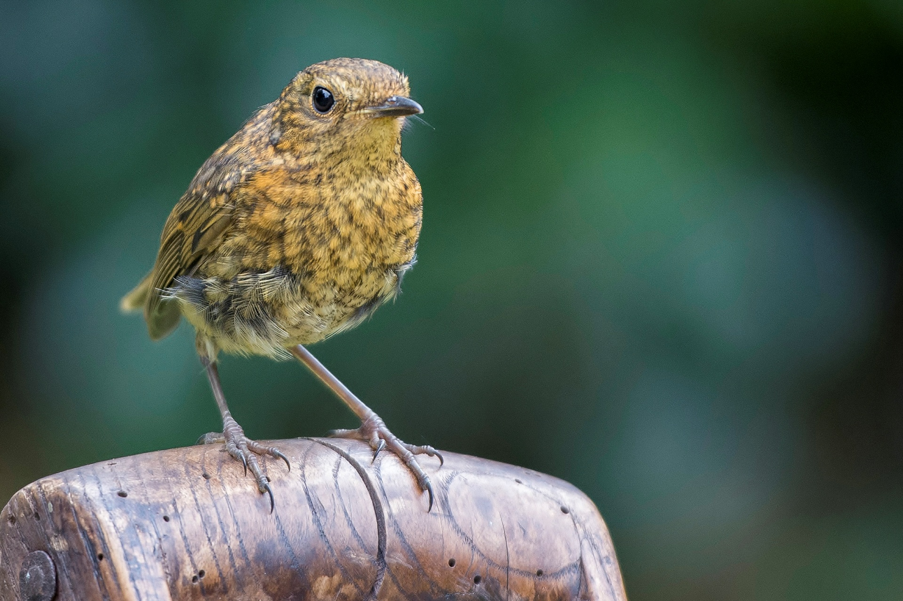
D7200 f.2.8 1/1000 sec ISO 800 200mm - 0.3 EC

Slide 14
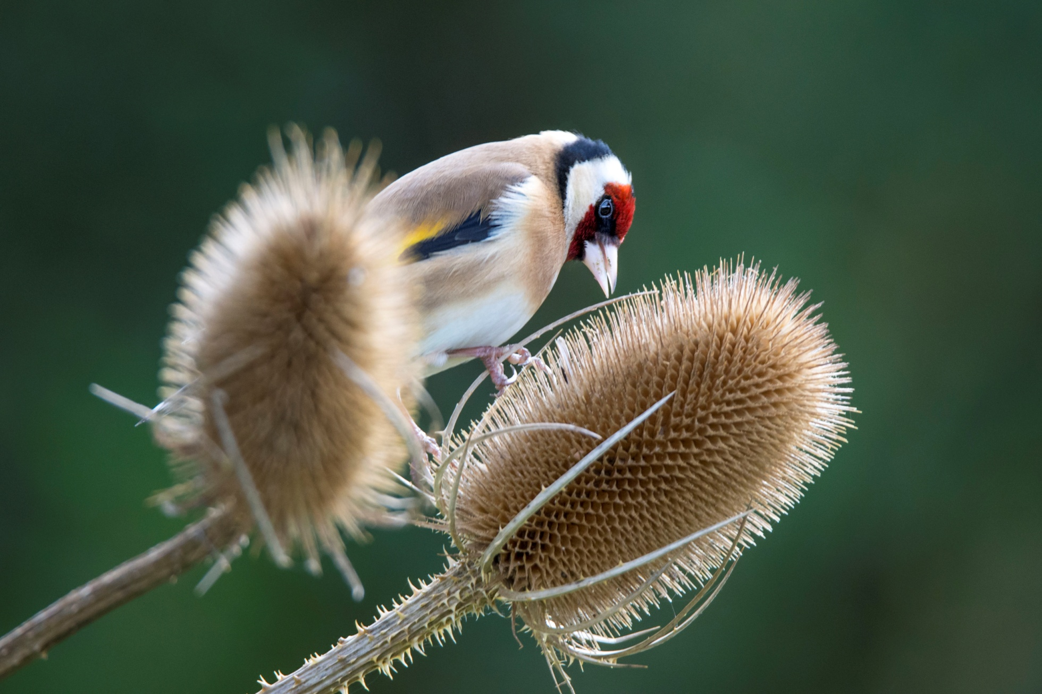
D7200 f.6.3 1/400 sec ISO 800 600mm No EC

Slide 15
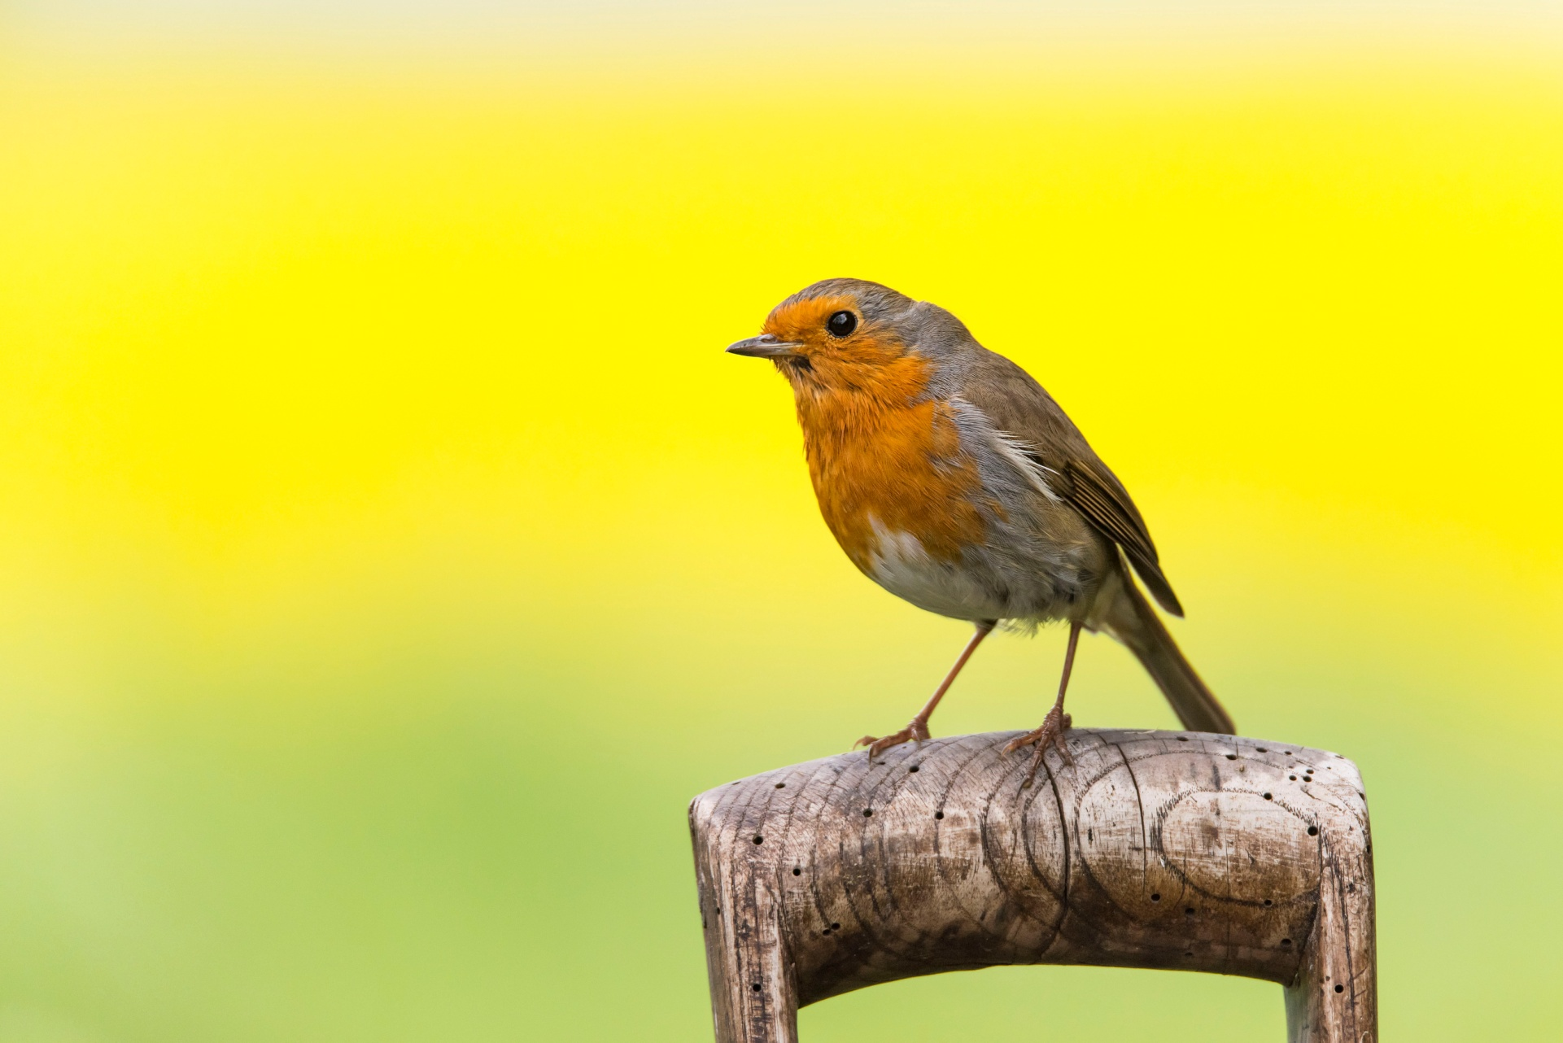
D810 f6.3 1/1000 sec ISO 64 600mm No EC

Slide 16
Nature in context
Nature in the Landscape
Sympathetic Image Cropping

Slide 17
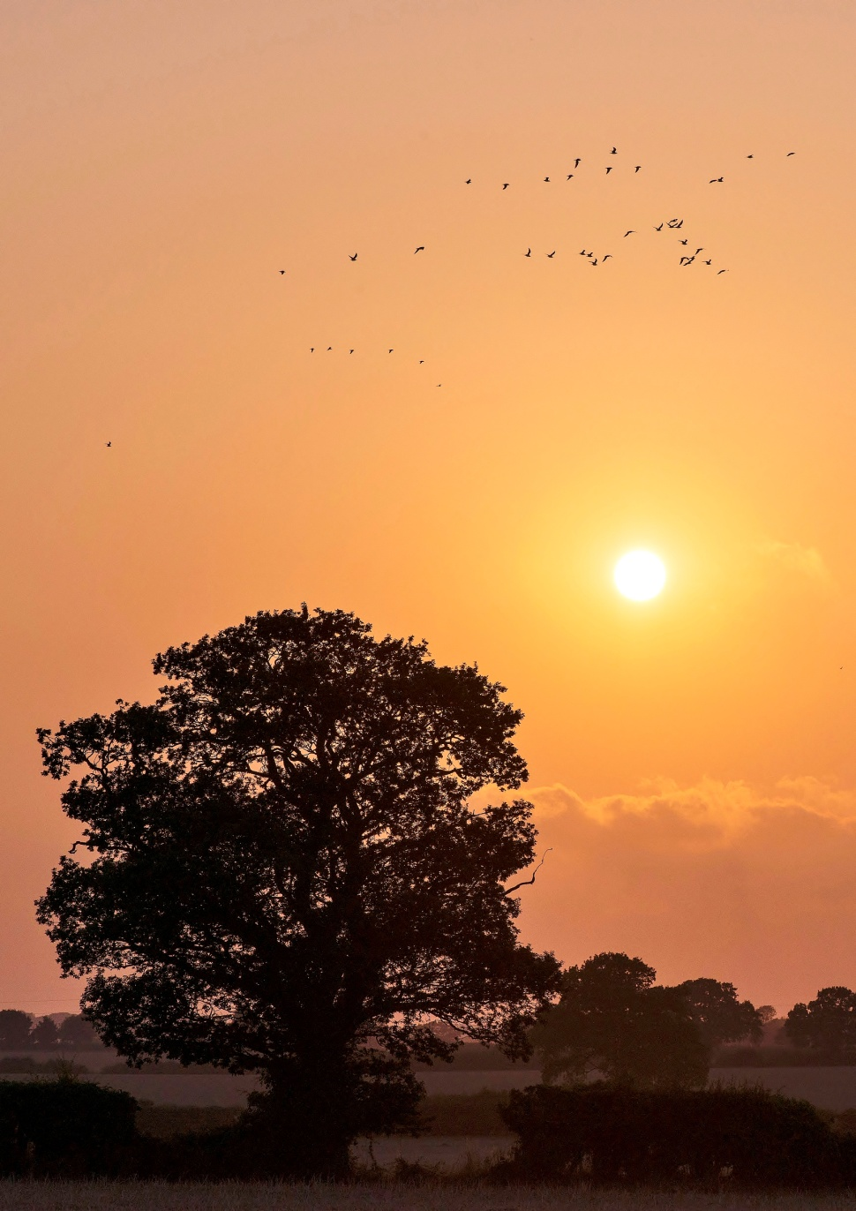
D800 f.11 1/3200 sec ISO 800 105 mm (Prime) – 0.7 EC

Slide 18
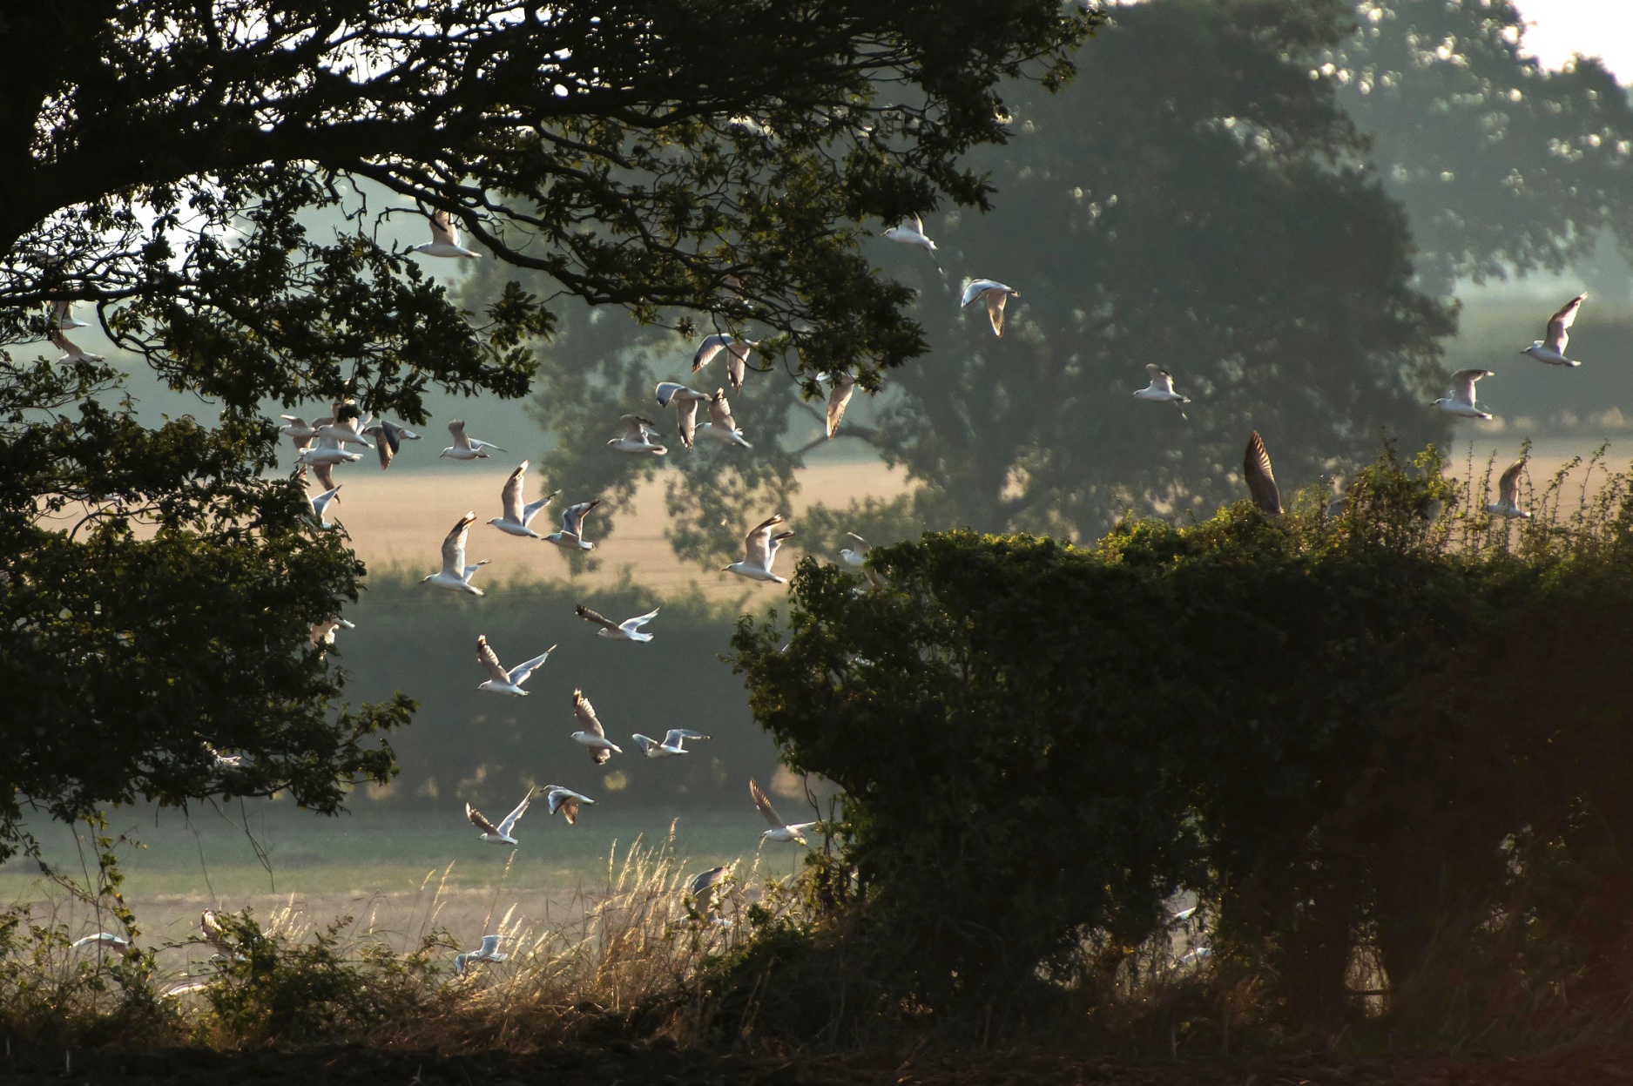
D800 f.5.6 1/3200 sec ISO 1000 400mm - 0.7 EC

Slide 19
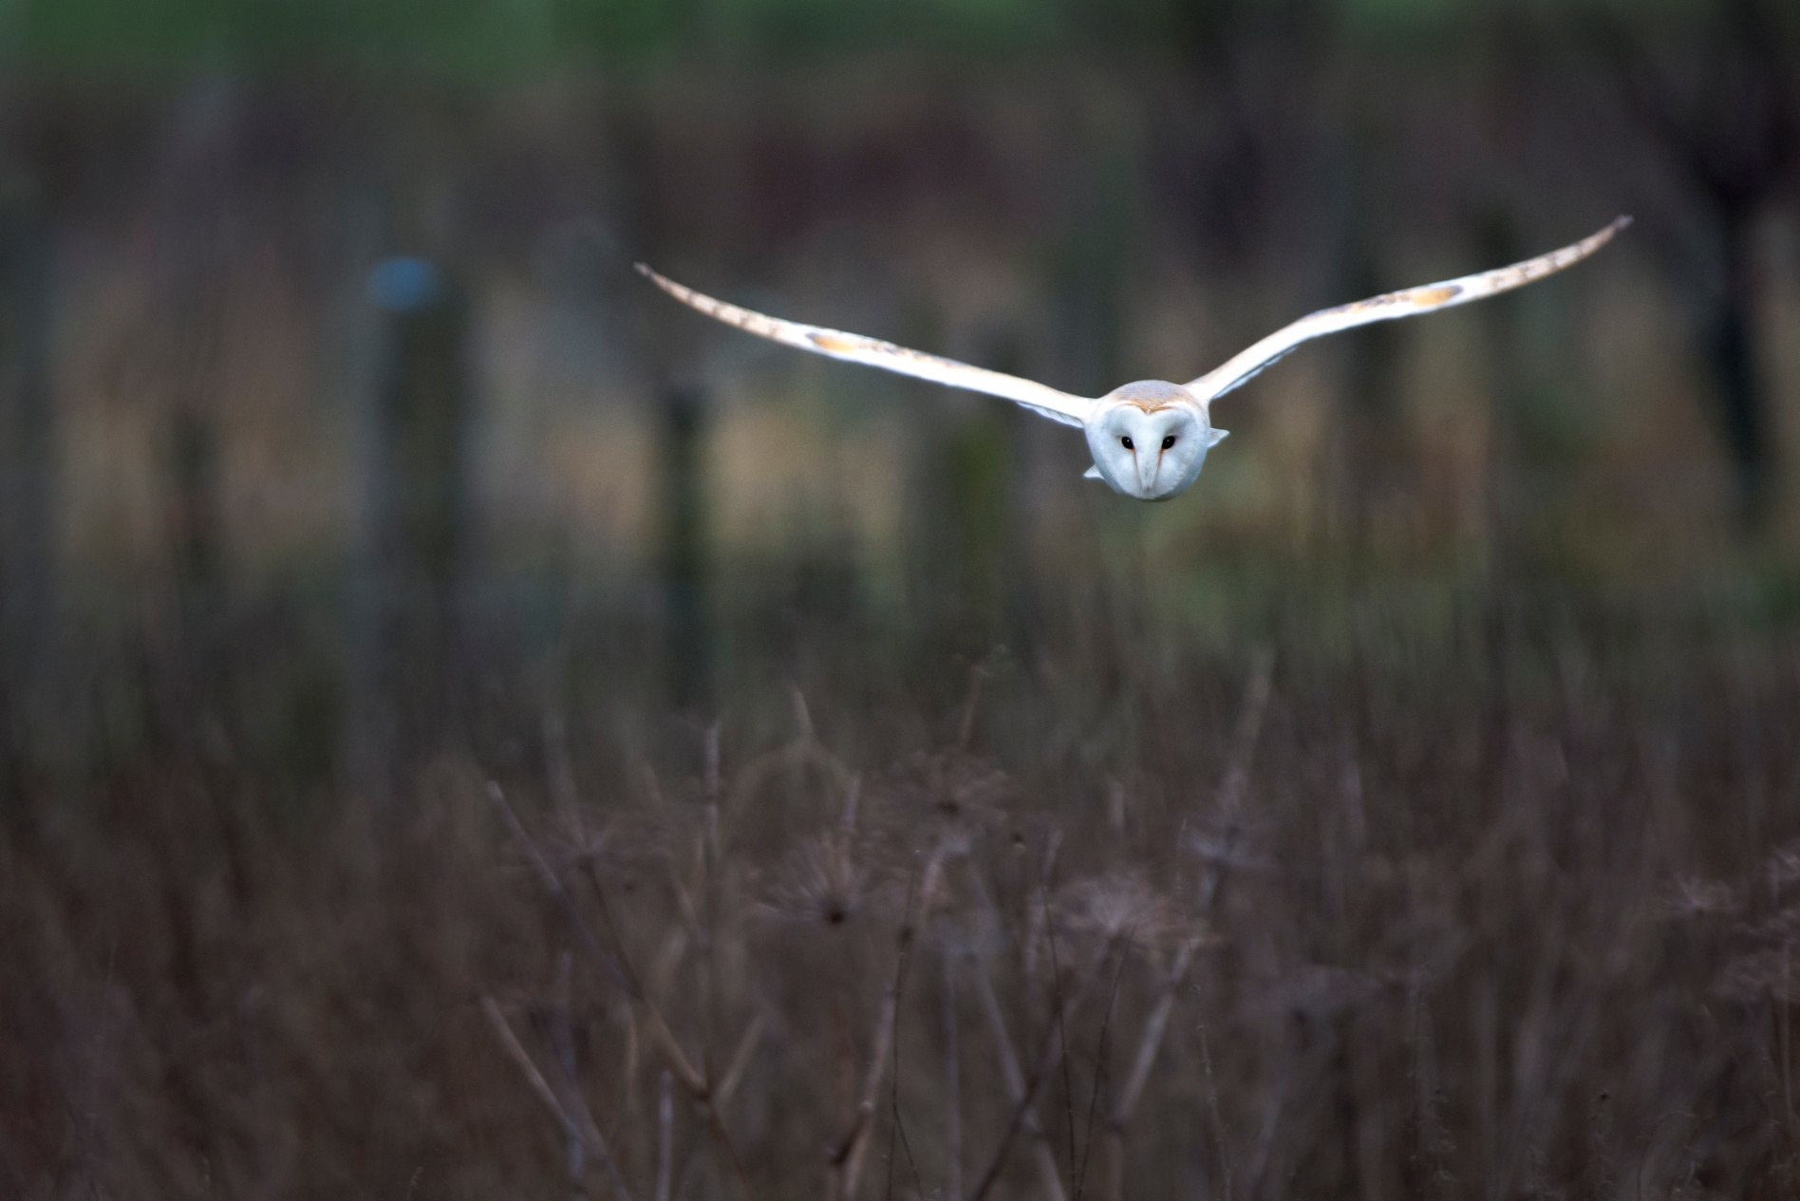
D7200 f.6.3 1/320 sec ISO 800 600mm - 0.3 EC

Slide 20
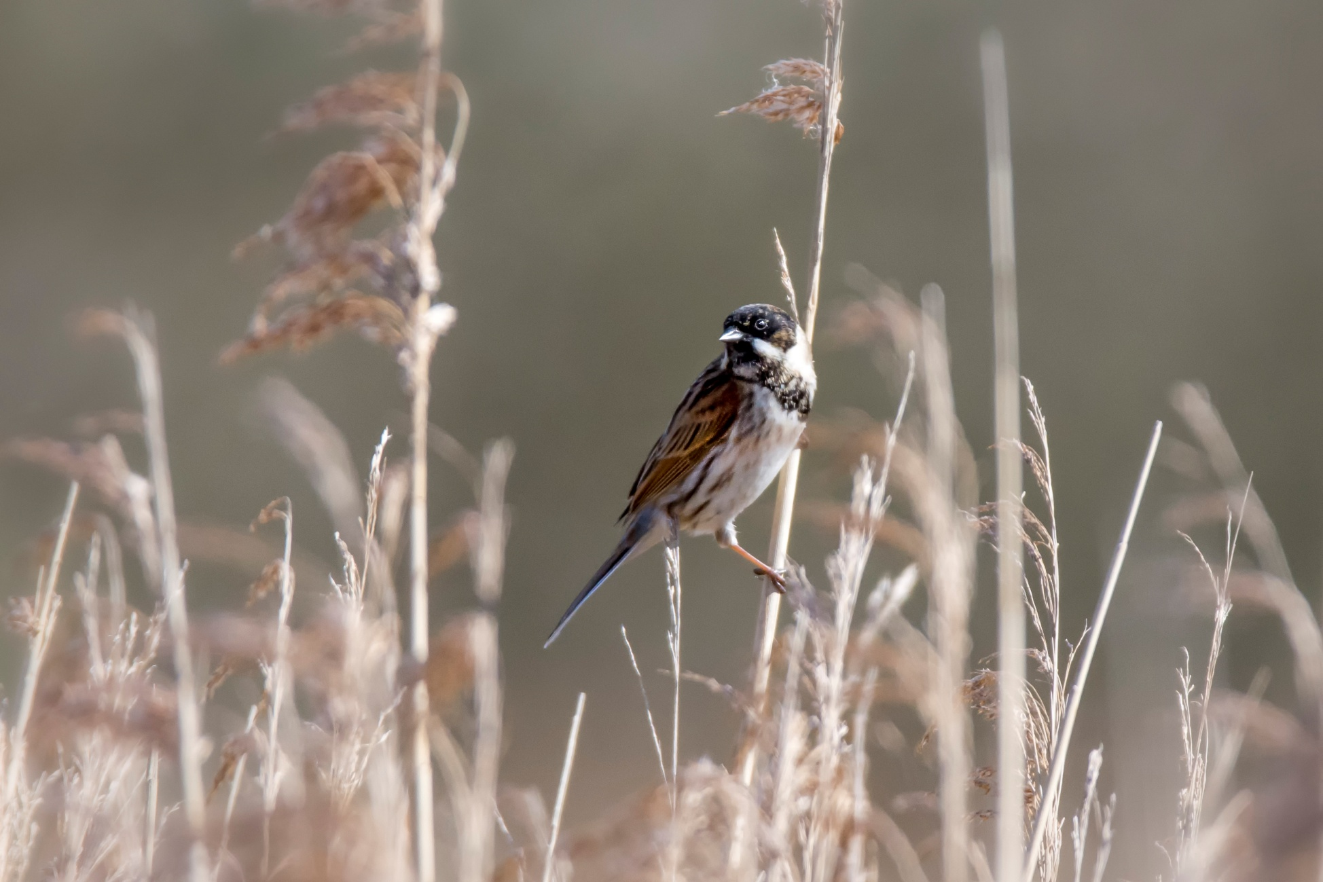
D7200 f.6.3 1/3200 sec ISO 800 600mm - 0.7 EC

Slide 21
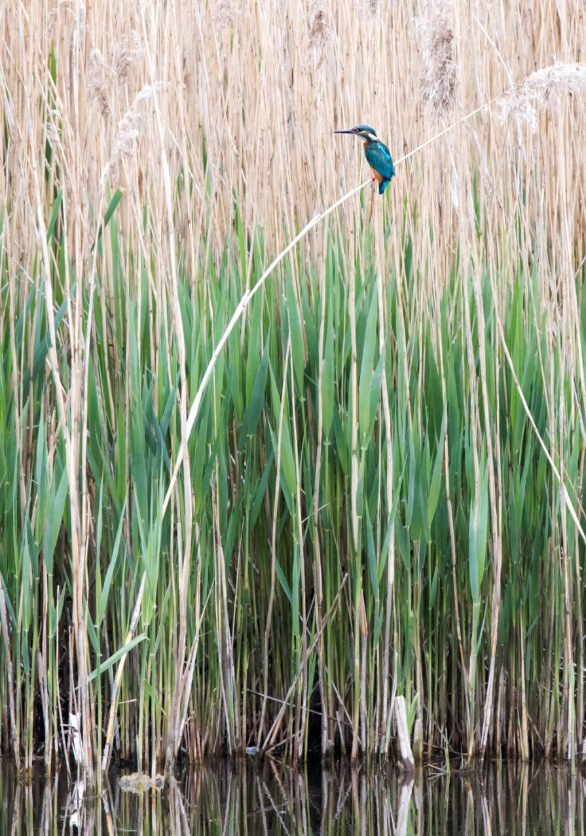
D810 f.8 1/800 sec ISO 800 600mm No E.C. Hand Held

Slide 22
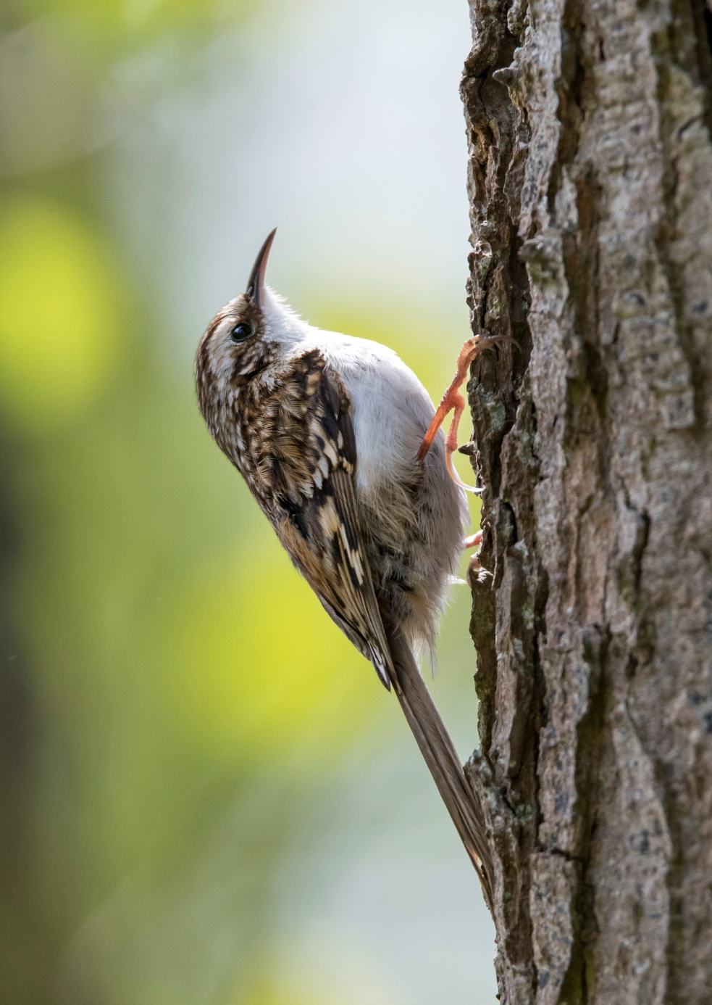
D810 f8 1/500sec ISO 800 600mm No EC

Slide 23
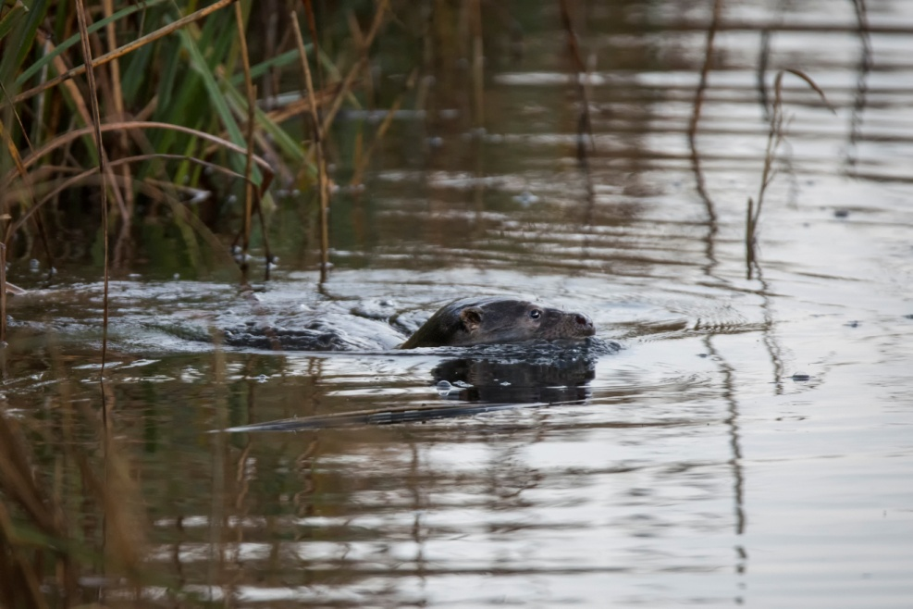
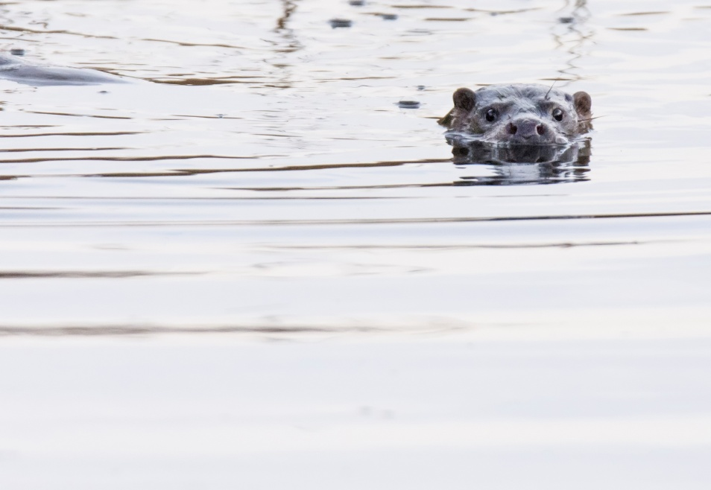
D7200 f.6.3 1/1250 sec ISO 600 600mm No EC

Slide 24
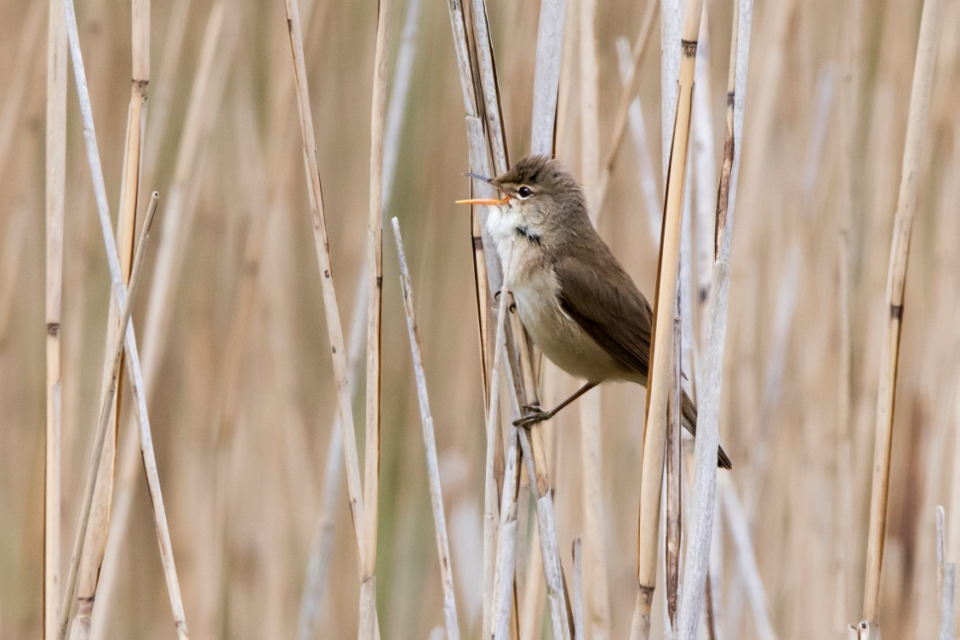
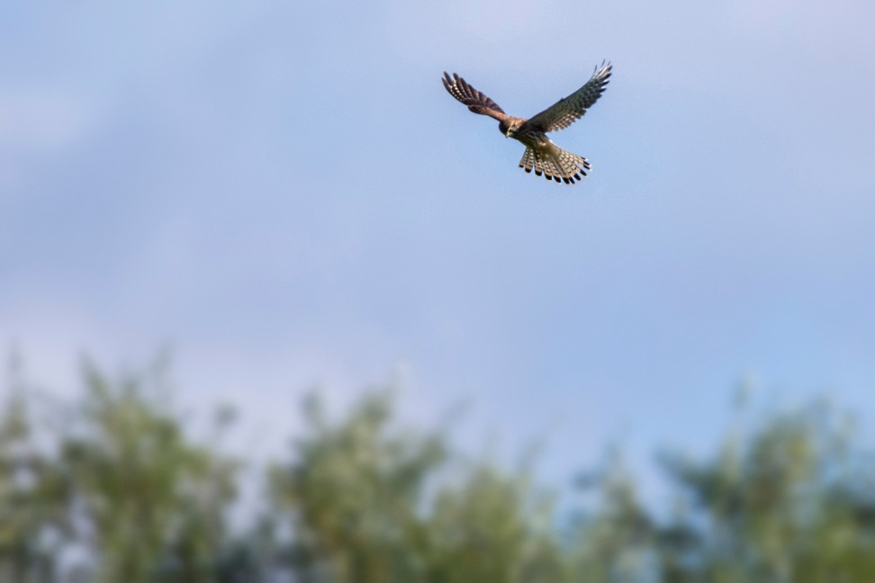
D7200 f.6.3 1/1250 sec ISO 600 600mm No EC

Slide 25
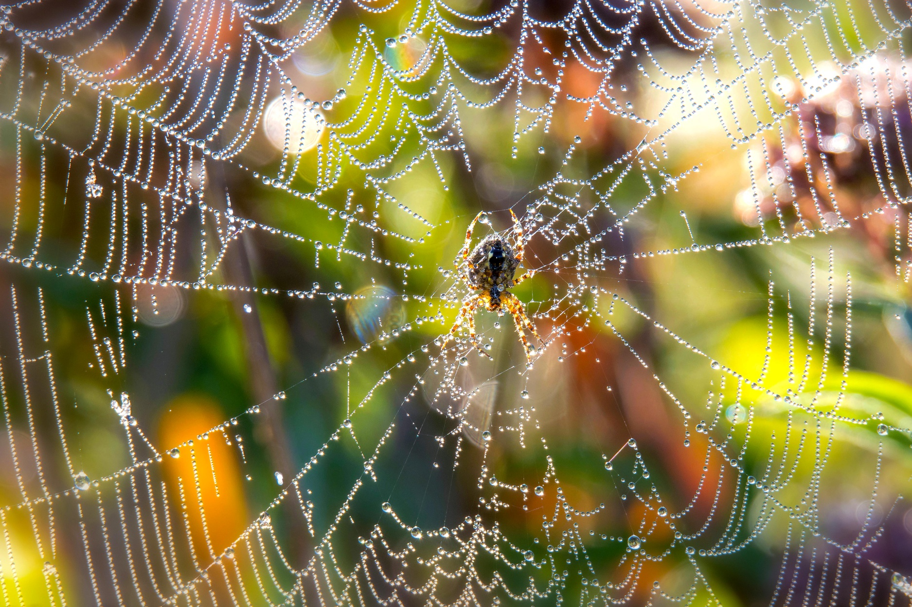
D7200 f.8 1/320 sec ISO 800 600mm No EC

Slide 26
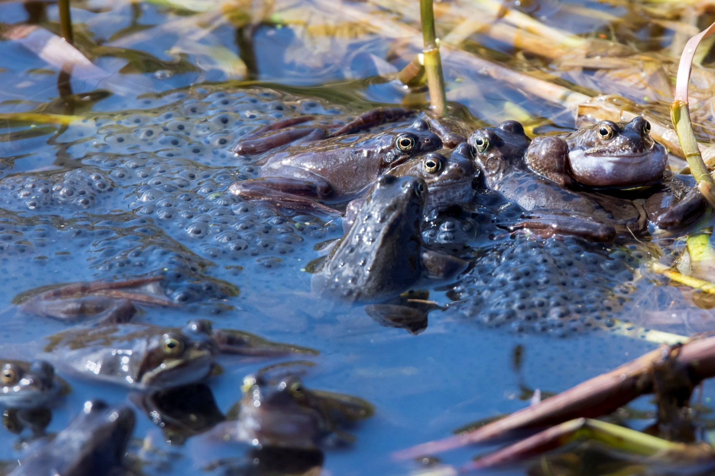
D7200 f.8 1/800 sec ISO 1000 600mm - 0.7 EC

Slide 27
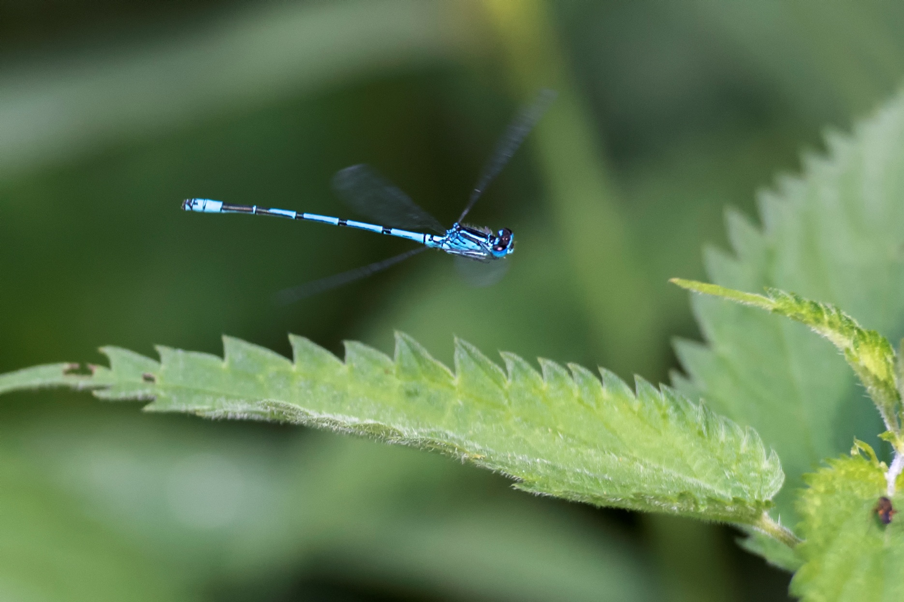
D7200 f.3.5 1/800 sec ISO 1250 200mm (Prime) No EC

Slide 28
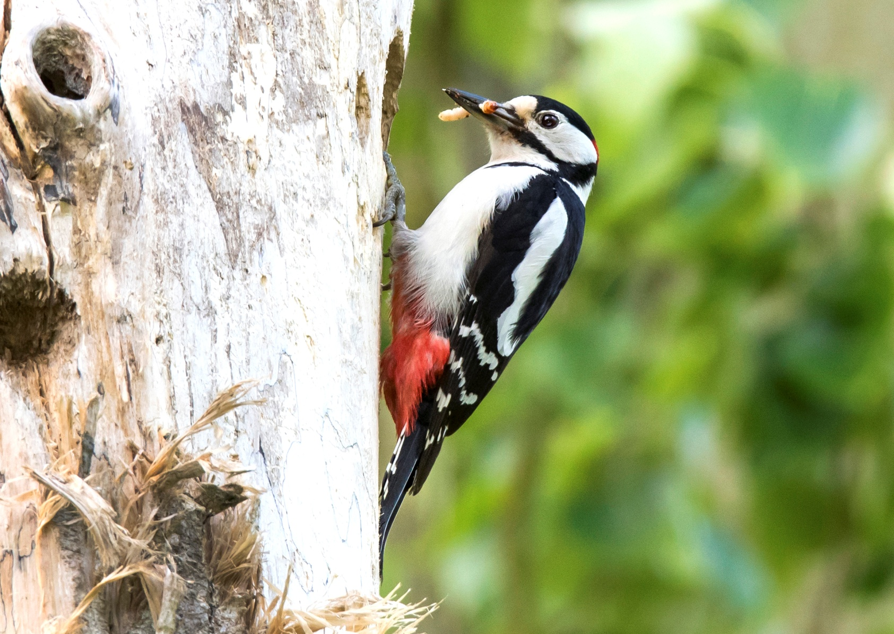
D810 f.10 1/250sec ISO 800 600mm Fill Flash

Slide 29
Some hints and tips
Does the subject relate to its surroundings or is it ‘over cropped’?
Consider your composition with the ‘rule of thirds’ in mind (but remember that rules are meant to be broken sometimes).
For birds in flight always use maximum point AF-C or AI Servo – target the bird in this mode and, as long as you keep it in the frame, it should be sharply focused. Alternatively, if you know where the birds flight path is (or a bird diving on a particular area to fish) you can manually pre-focus – but unless you’ve practised fast manual focussing, good luck with that!
Consider using back button focusing so the camera will not re-focus when you press the shutter button. It takes getting used to but it’s more than worth it.

Slide 30
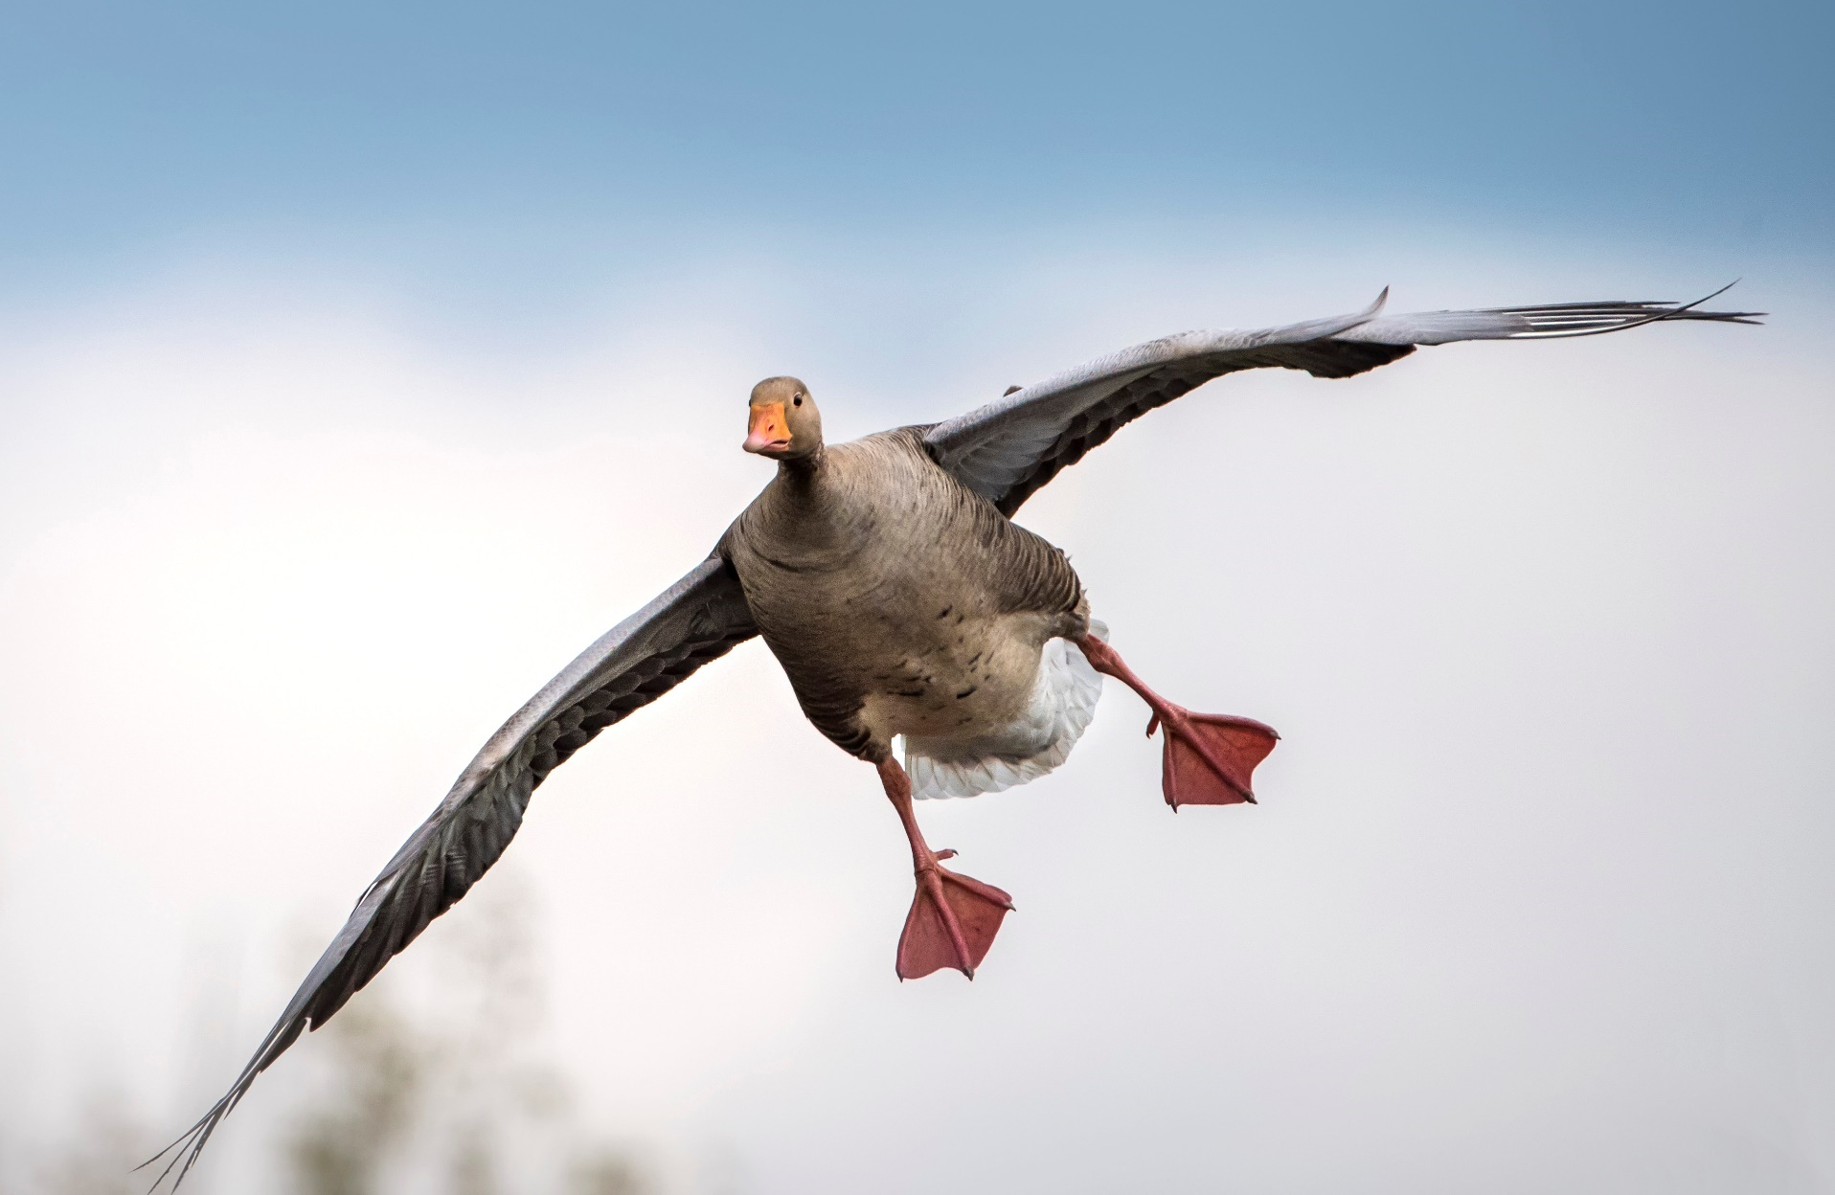
D810 f9 1/2000sec ISO 800 600m No EC

Slide 31
Image making as well as image taking
One of the ways to make your images stand out is to create them so why not try something different.

Slide 32
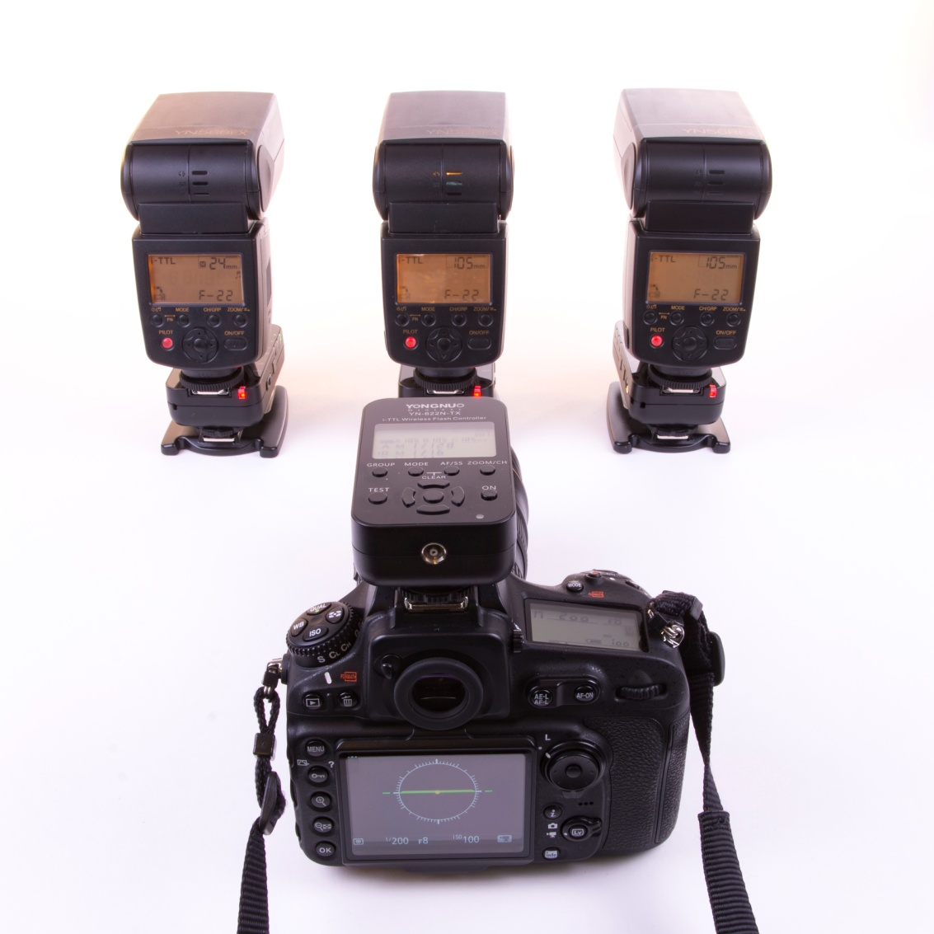
Off Camera Flash

Slide 33
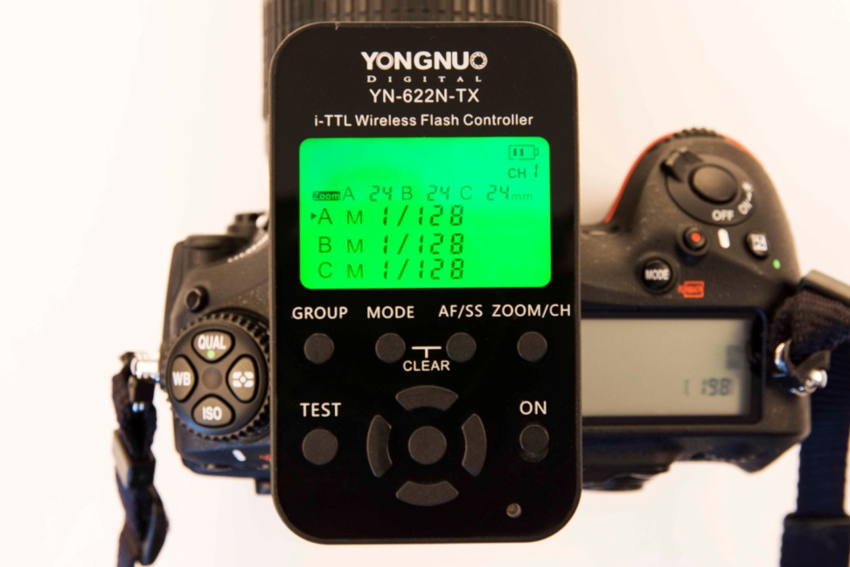
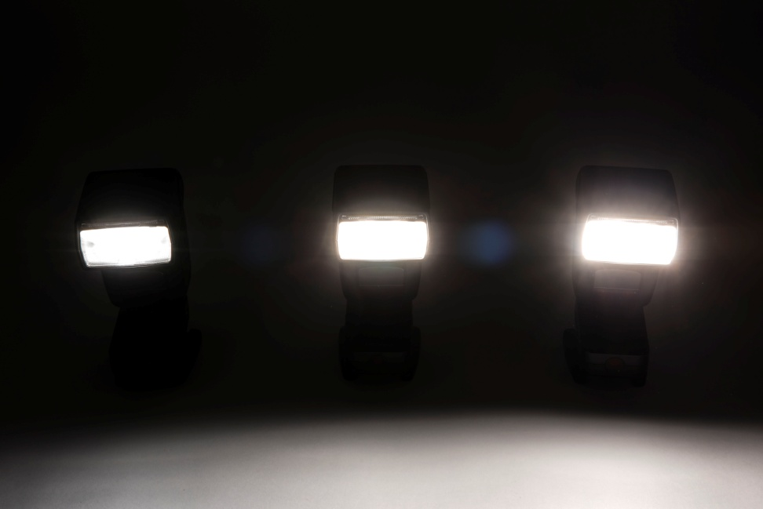
Off Camera Flash Cont’d
Flash Transceiver
Variable Power

Slide 34
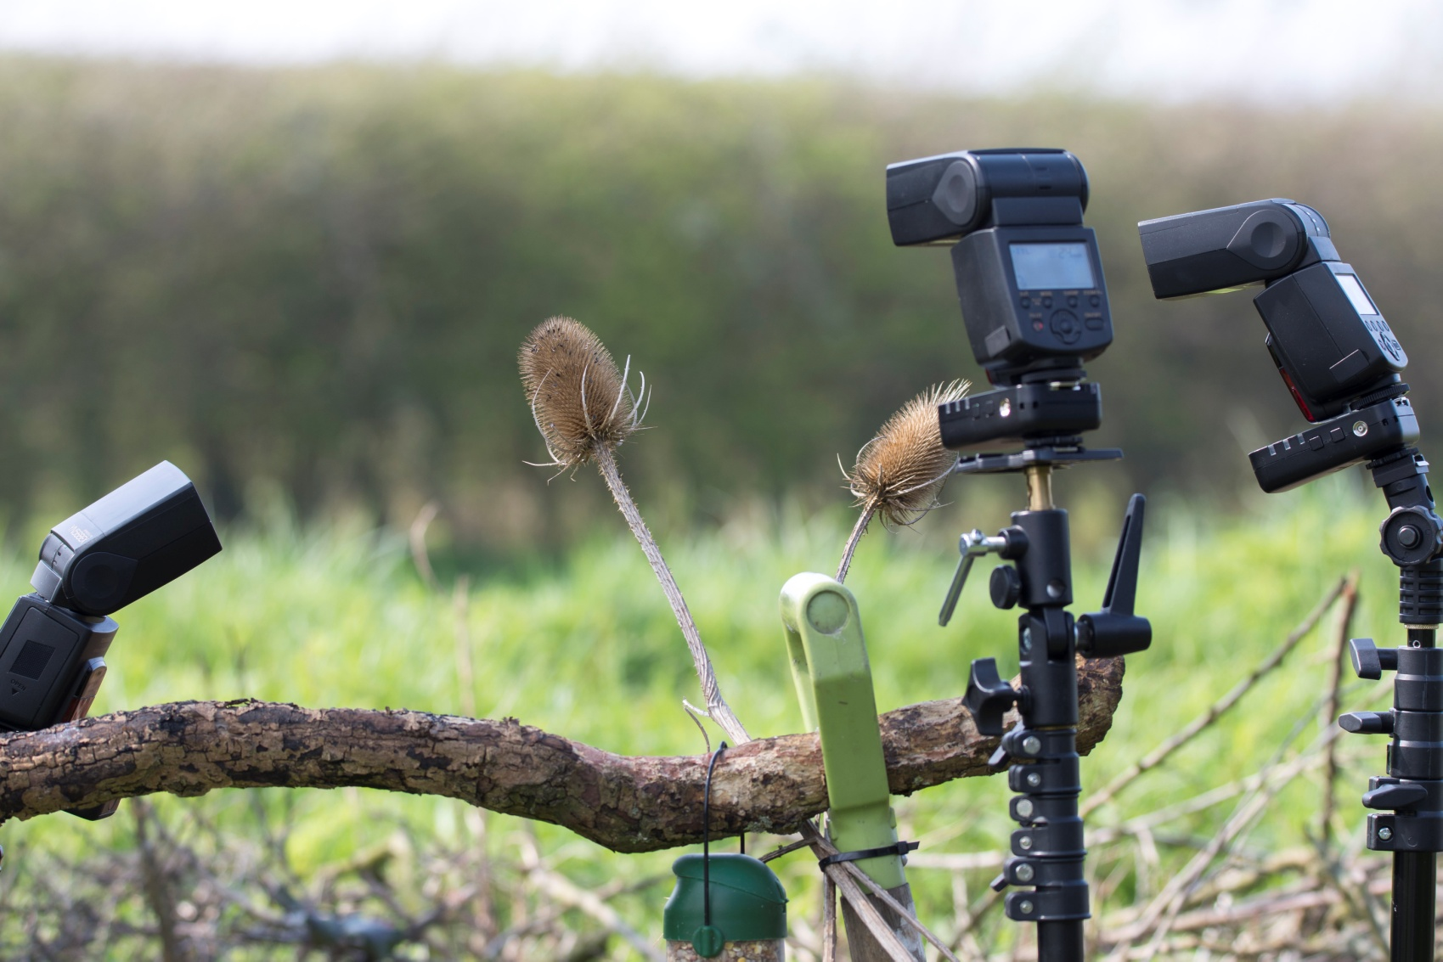
Off Camera Flash Cont’d

Slide 35
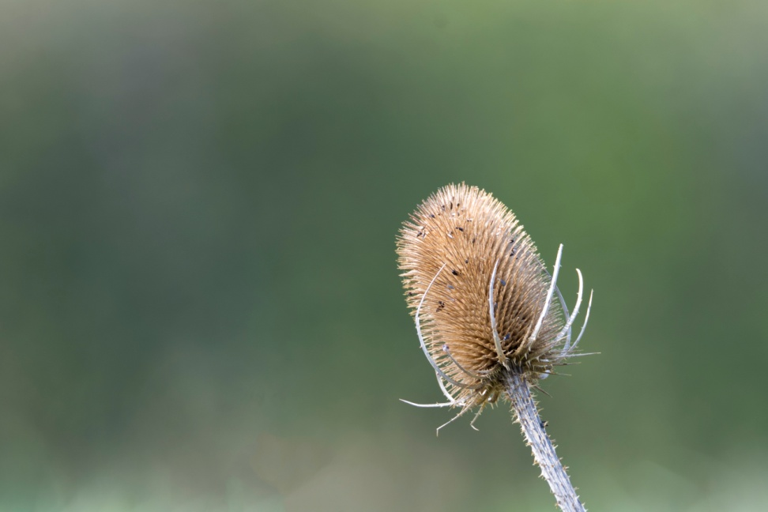
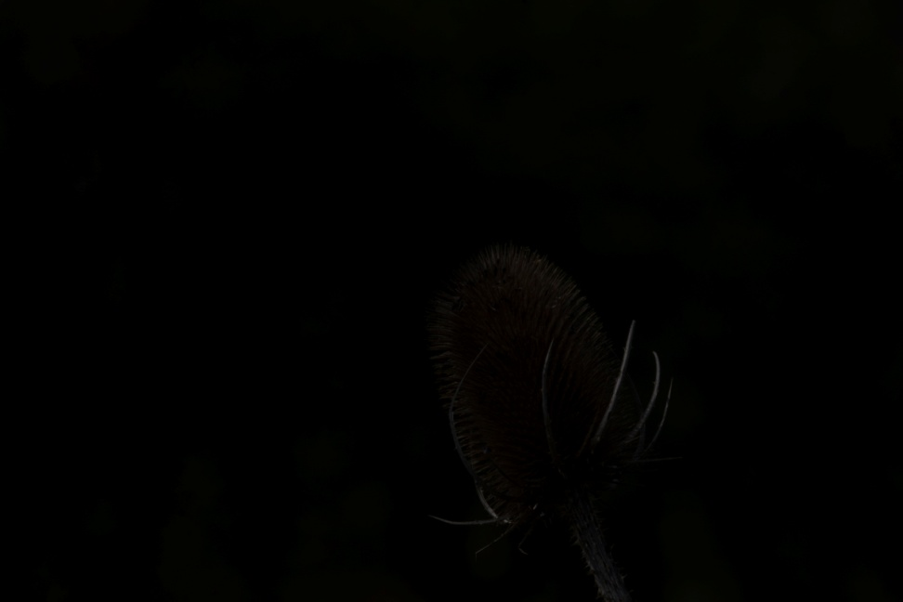
Off Camera Flash Cont’d
Ambient Light
F.6 1/60 sec iso 100 400mm no ec
Ambient light dialled out
F.22 1/200 sec iso 100 400mm +0.3 EC

Slide 36
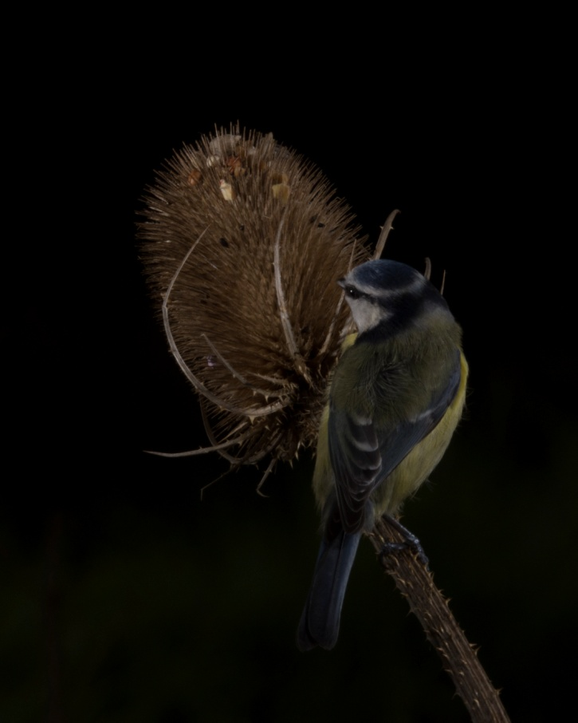
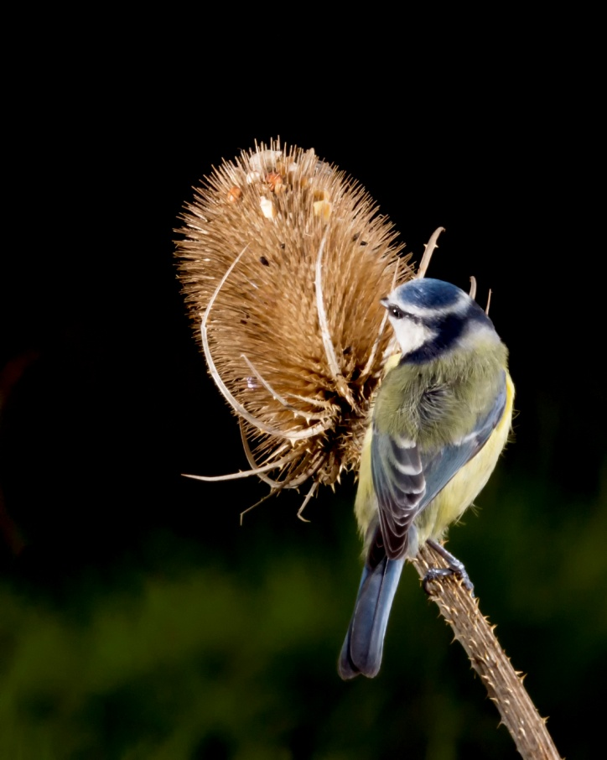
Off Camera Flash Cont’d
Raw image
Raw image processed

Slide 37
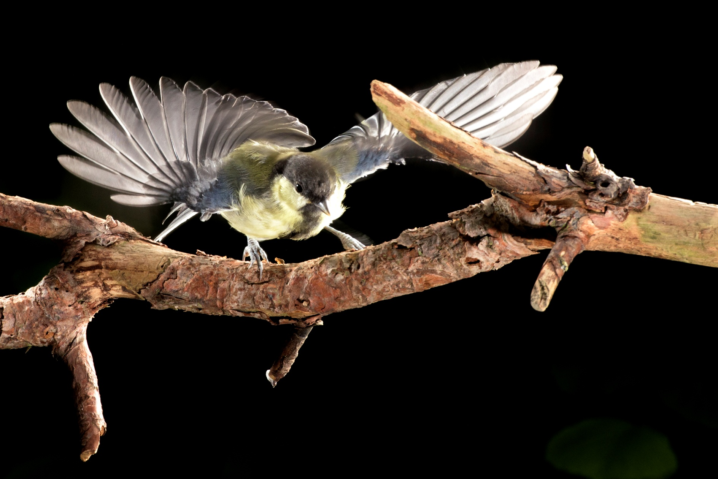
D810 f.16 1/200 sec ISO800 200mm No EC (OCF 1/128 power appx 1/30,000 sec)

Slide 38
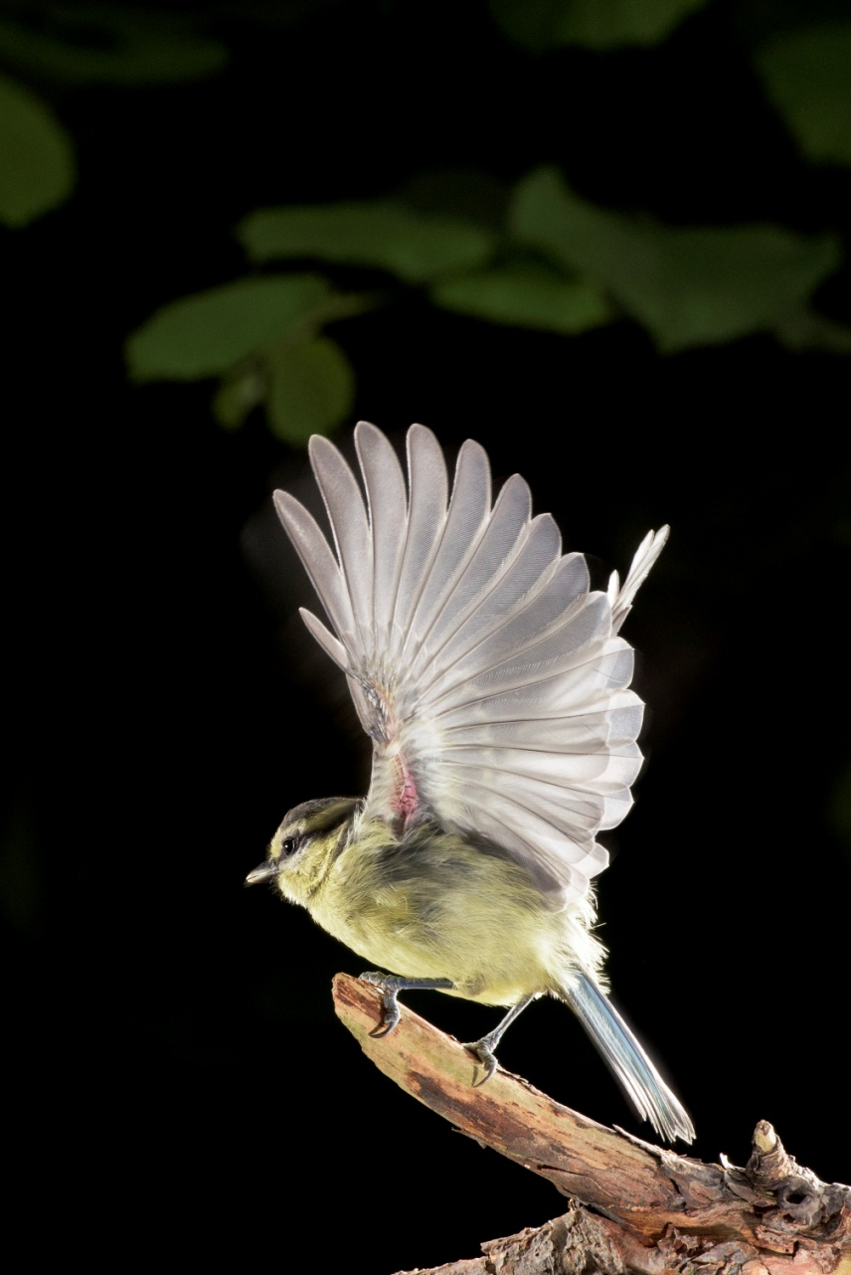
D810 f.16 1/200 sec ISO800 200mm No EC

Slide 39
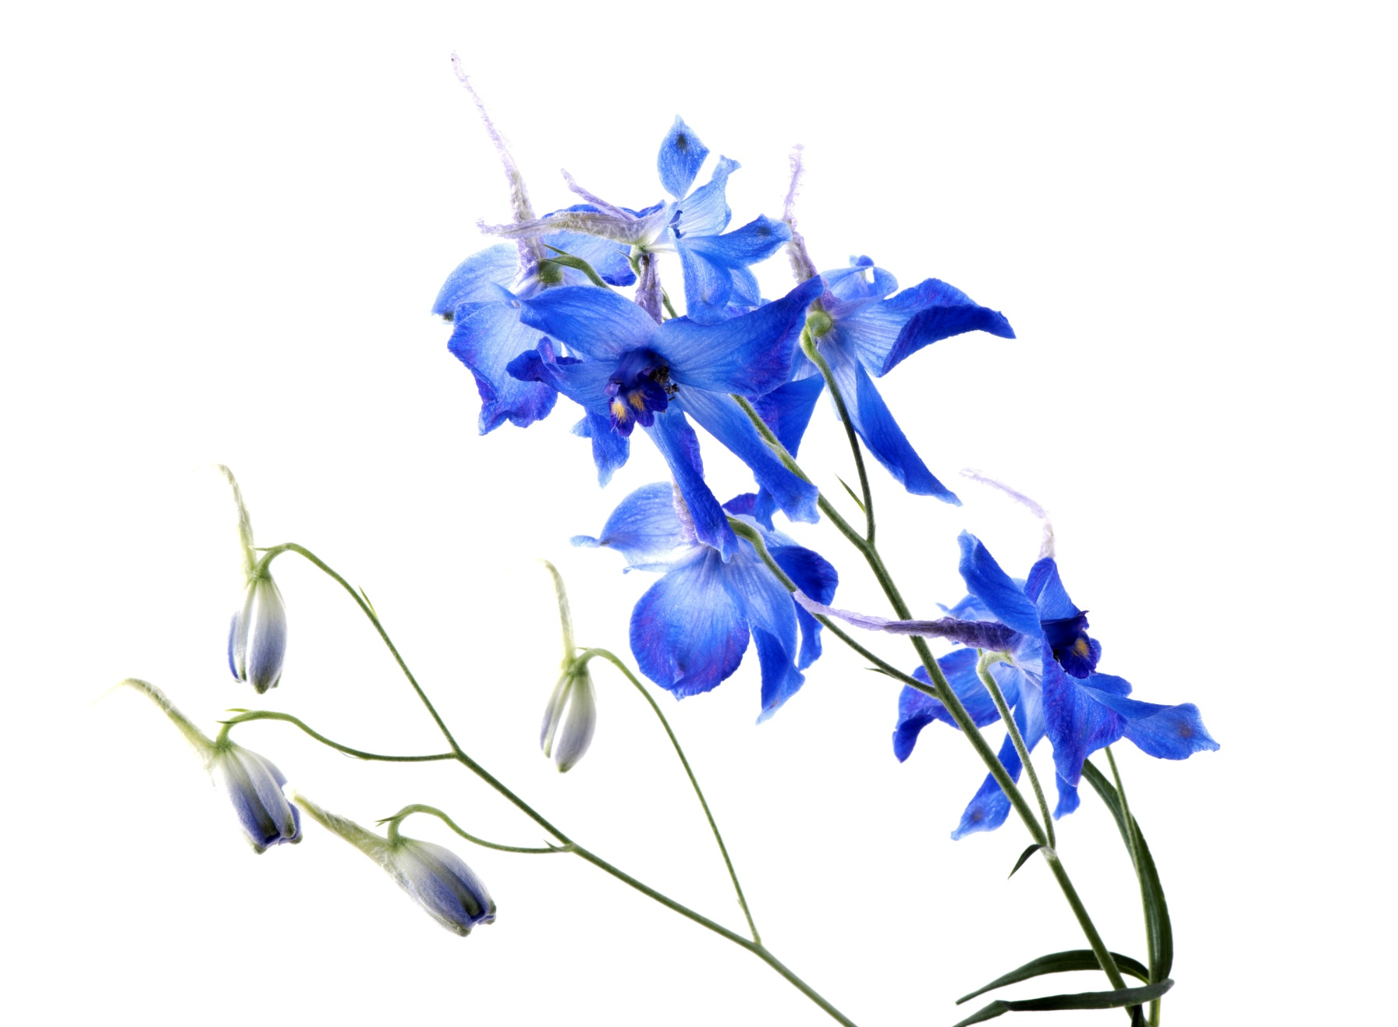
D810 f18 1/200 sec 105mm Macro No EC

Slide 40
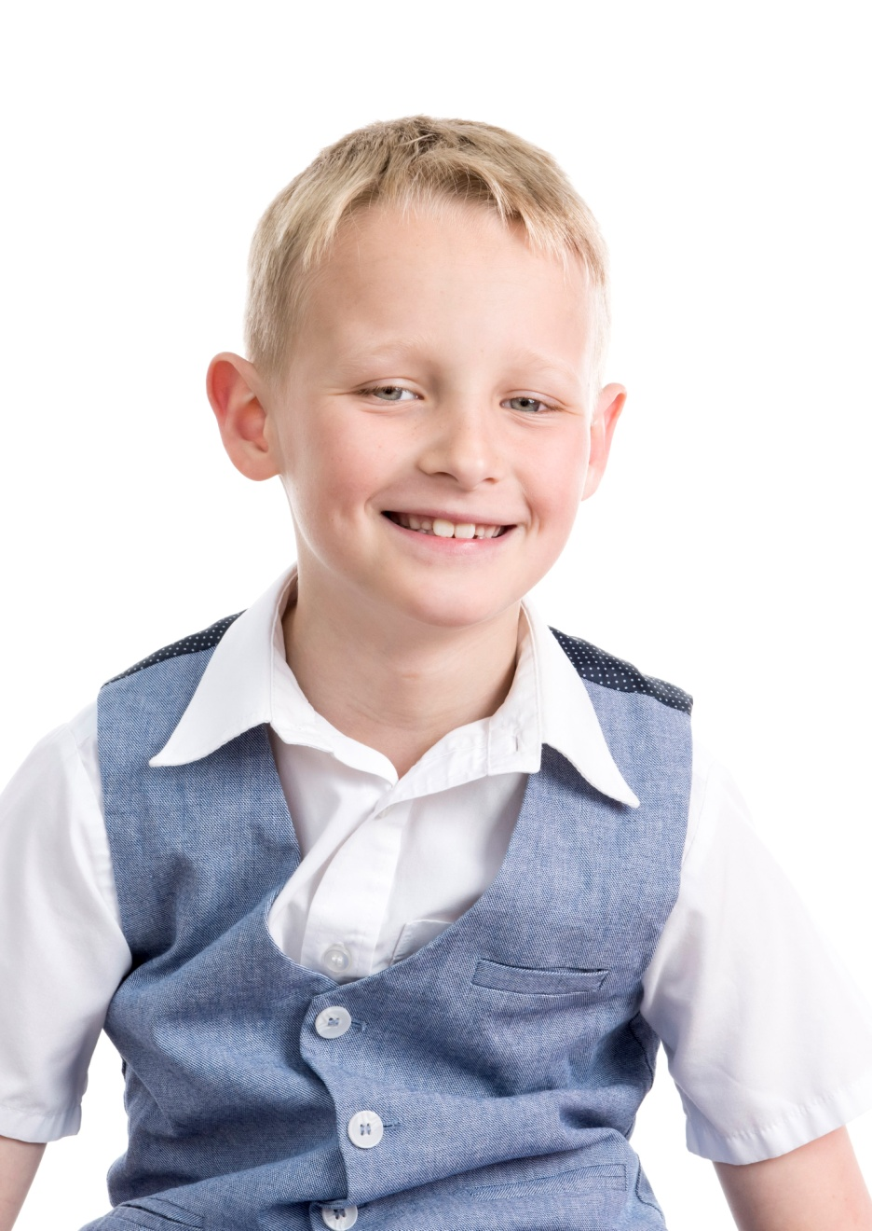
D810 f.14 1/125 sec ISO 320 70mm No EC

Slide 41
Close-up and macro
While we are using our ‘long’ lenses we are inevitably missing what’s under our noses so why not try ‘thinking small’.
Getting really close can bring some amazing images but also brings new challenges.

Slide 42
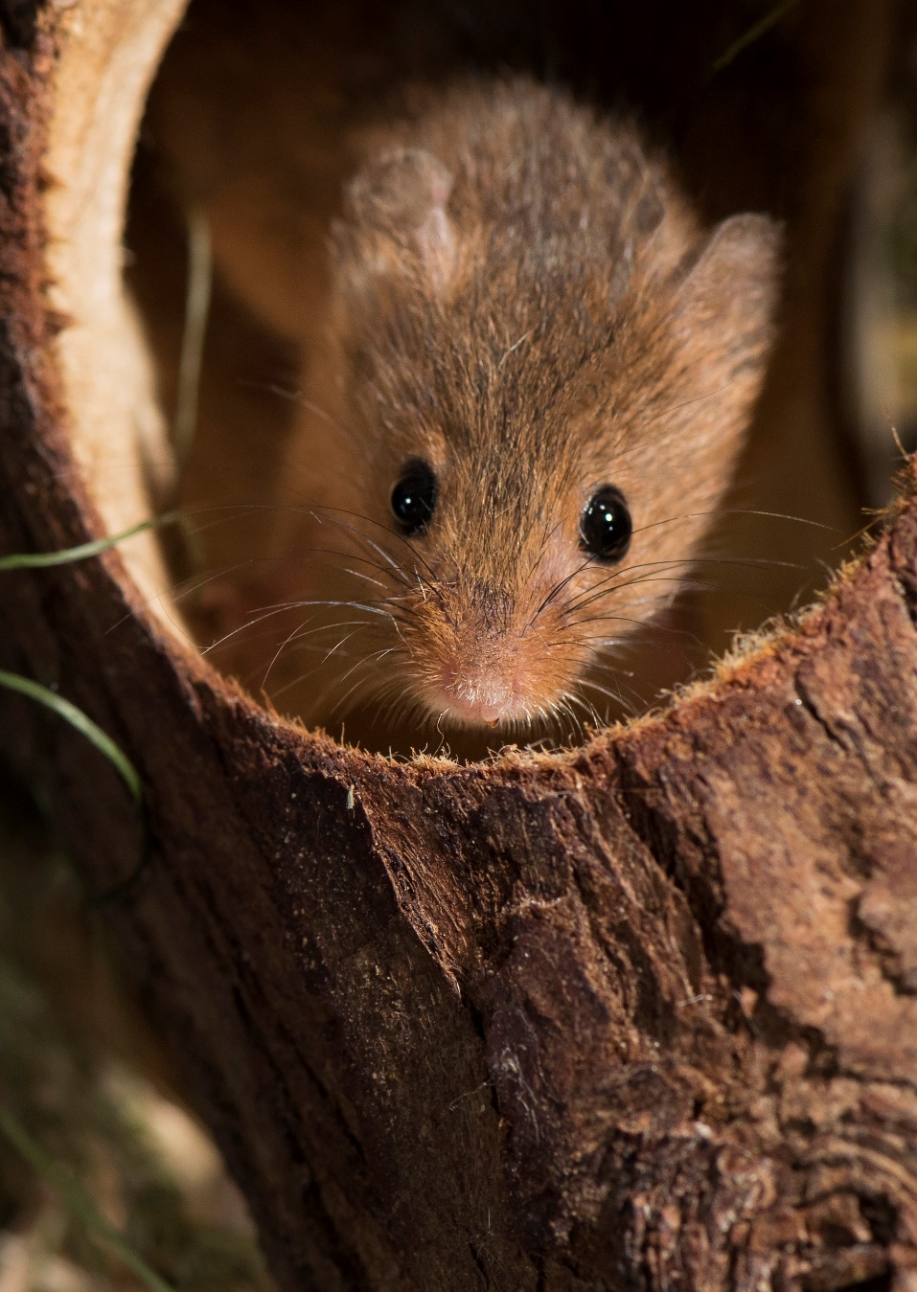
D810 F:8 1/200sec ISO 400 105mm No EC

Slide 43
Macro & Close-Up Equipment
These are the basics:
DSLR or Bridge with Macro Settings
Tripod
A dedicated lens with Macro (x1) Capability
Or a 35mm or 50mm Prime Lens
Close Up Filters
Extension Tubes
Extreme Macro will require off camera light
Clamps (for holding subjects still)
Remote Shutter Release

Slide 44
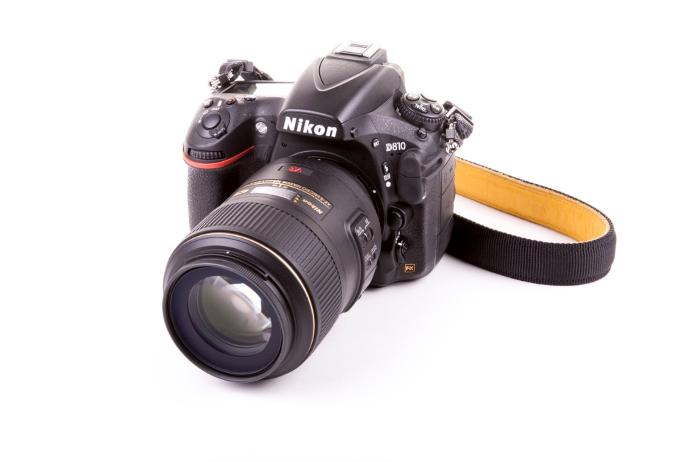
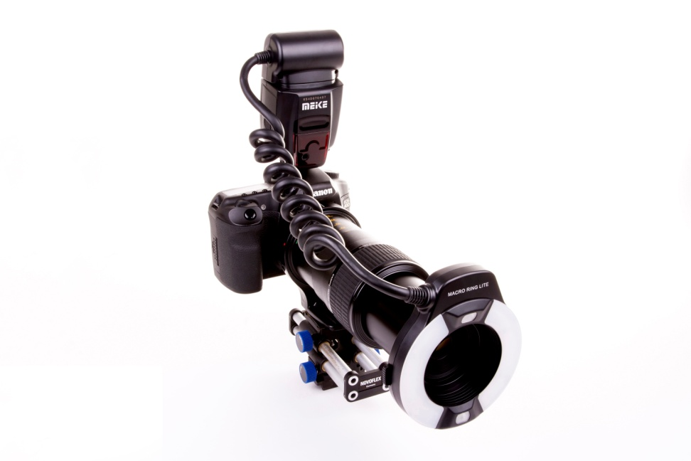
Macro Equipment Cont’d
Nikon D810 105mm Macro
Canon eos 40d Mp-e 65mm macro

Slide 45
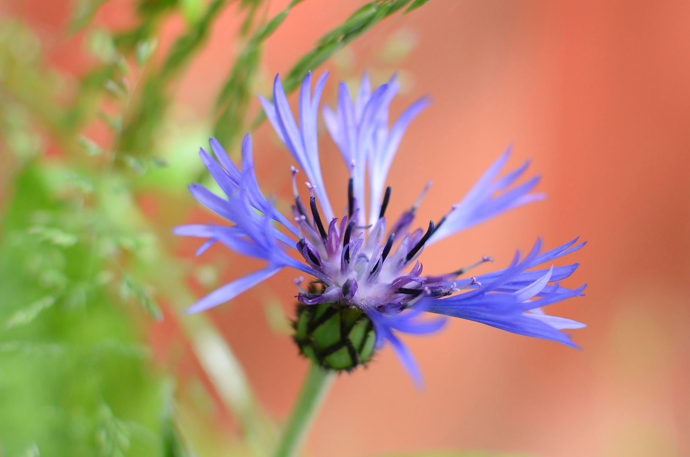
D7000 f.2.2 1/1000 sec ISO 400 35 (50)mm No EC

Slide 46
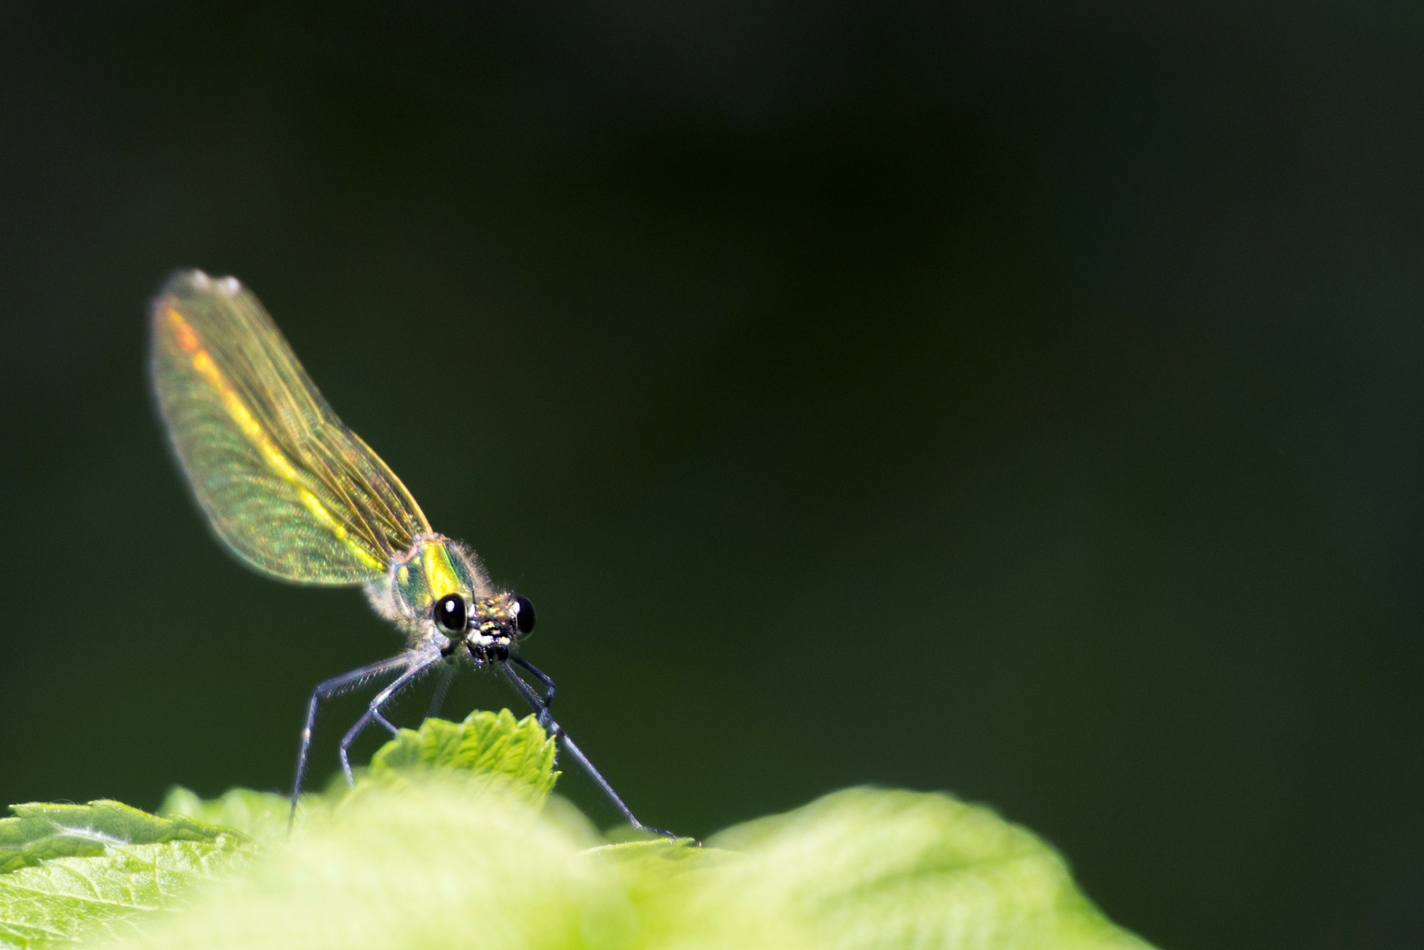
D7200 f.5.6 1/320 sec ISO 400 400mm (200mm + 2x TC) - 0.3 EC

Slide 47
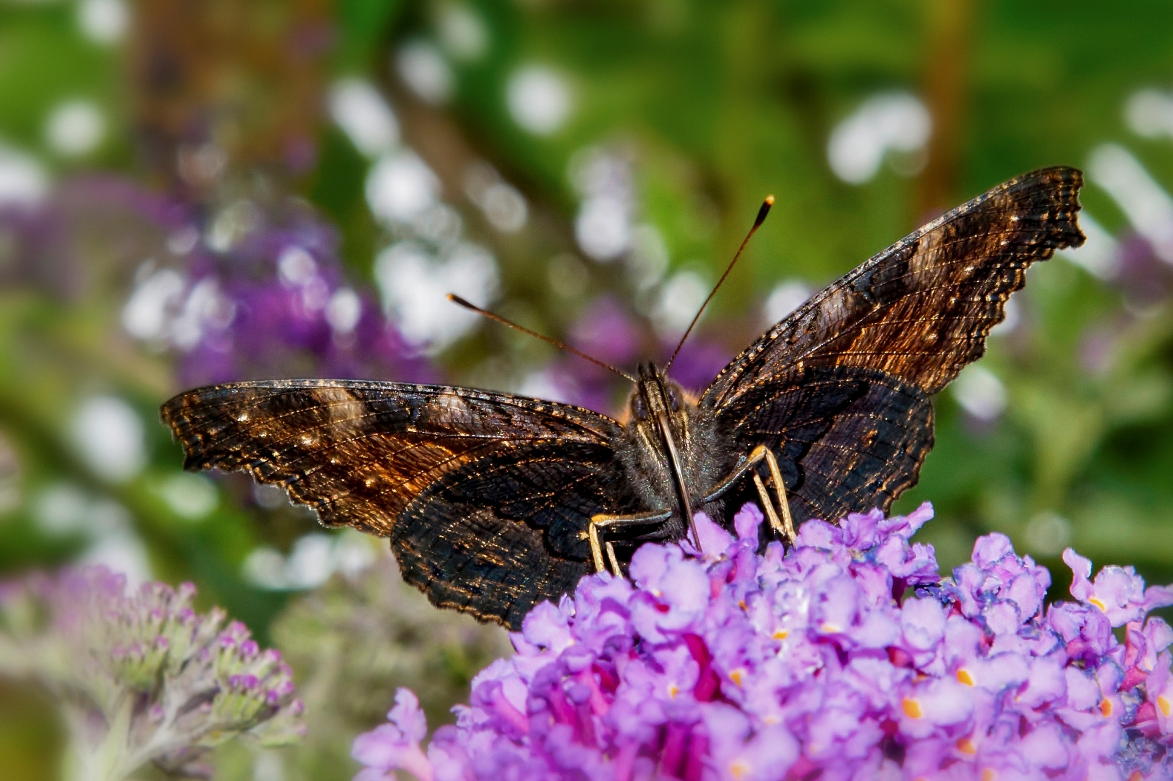
D800 f.18 1/100 sec ISO800 70mm -1 EC

Slide 48
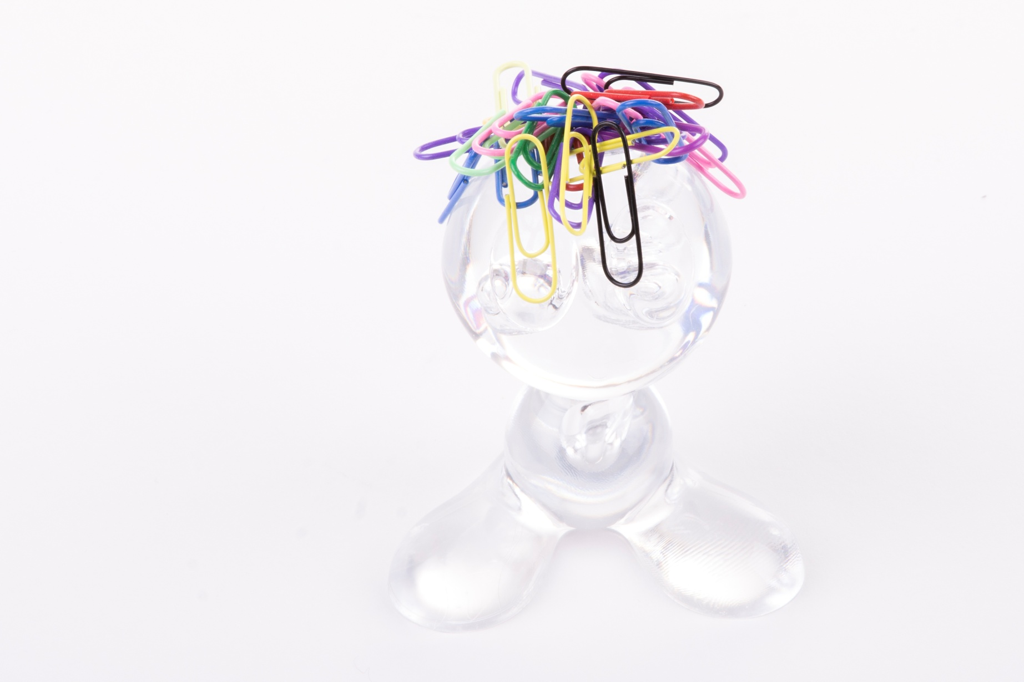
D7200 f.18 1/200 sec ISO100 85mm No EC

Slide 49
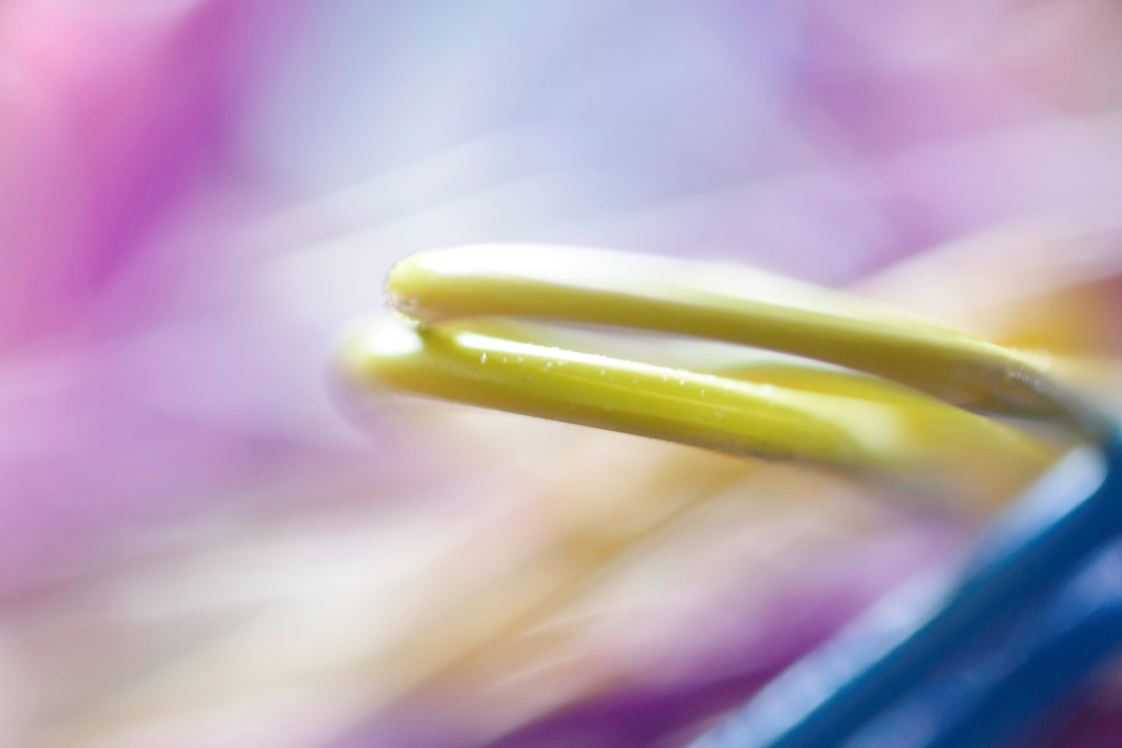
EOS 40D f.2.8 1/15 sec ISO200 65mm (x1.5 Magnification) No EC

Slide 50
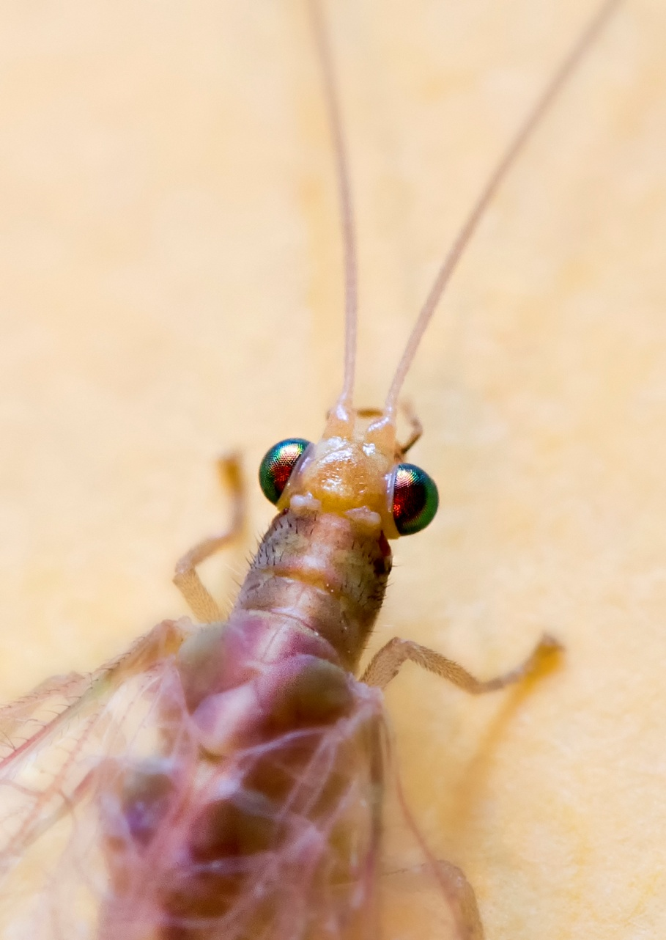
D810 f.8 1/1/2 sec ISO 400 105mm Prime (x1 magnification) No EC

Slide 51

D810 f.18 1/200 sec ISO 64 105mm Prime (x1 magnification) No EC

Slide 52

D7000 f.8 1/250 sec ISO 400 105mm Prime No EC

Slide 53

D810 f.18 1/200 sec ISO 64 105mm (Prime) No EC

Slide 54


Focus Stacking for Macro
A brief explanation:

Slide 55

EOS 40D f.16 1/250 sec ISO 100 MP-E 65mm (x2 Magnification) No EC

Slide 56

EOS 40D f.16 4 sec ISO 100 65mm x2 Magnification No EC

Slide 57
Night Photography
A shot in the dark

Slide 58
Hints & Tips for Night Shooting
Night shooting can be cold and damp. Always wrap up warm and have a micro fibre cloth to keep the lens mist free and the camera dry.
To plan outdoor shoots in natural light and for accurate data on sunrise/sunset, moon rise/moon set locations and timings consult The Photographers Ephemeris (TPE), a widely available Mac & Android App.
Another App for night skies is the Stellarium Mobile Sky Map which is a planetarium in your pocket and works in real time for plotting constellations , planets and stars.
For long exposures of the night sky use the ‘mirror up’ facility on DSLR’s to reduce camera shake (not important with EVF’s) and always use a remote shutter release (preferably wireless electronic).
Exposures of the night sky over 30 seconds will start to bring blurring through the earth’s movement so remember the ‘exposure triangle’.

Slide 59

D7000 f.22 13 secs ISO 400 16mm No EC (OCF Full Power unsynchronised)

Slide 60

D7200 f.20 1/80 sec ISO 100 600mm No EC

Slide 61

D7200 f.6.3 1/1/2 sec ISO 800 600mm No EC

Slide 62

Experiment in Photoshop or Elements

Slide 63

Experiment in Photoshop or Elements Cont’d

Slide 64

Experiment in Photoshop or Elements Cont’d

Slide 65
Hints & Tips For Photoshop & Elements
Shoot in RAW for complete control over image adjustments in post processing.
Start simply and find the easy tools for :
Exposure ( Levels & Curves, Brightness & Contrast)
Cropping
Image sizing (for printing or web)
Spot removal (unwanted objects and sensor dust etc.)
Localised sharpening
Image noise reduction
White balance correction, saturation & vibrance
Use You tube tutorials to get the best from Photoshop & Photoshop Elements. For example; type in ‘focus stacking in Photoshop’ and several useful videos will guide you through it. This also applies to every photographic topic so there’s no excuse not to keep learning.
Above all experiment! If you make a copy of an important photo, you can’t hurt the original and you will be able to enhance your images with confidence.

Slide 66

D7200 f.8 1/320 sec ISO 800 400mm No EC
Photoshop: Black & White Conversion/Increased Contrast/ Solarising Filter (to enhance wing pattern)

Slide 67
Some closing thoughts
It should go without saying but when photographing wildlife, wear ‘blend in’ clothing and keep still and quiet. Even in a hide, sound travels!
Always have a plan for your next shots – the less you leave to chance the more successful you’ll be.
Always consider the background and keep it as clean and uncluttered as possible.
Try something different and work towards your ‘signature style’ which will set you apart from the average.
And finally, to quote Henry Ford, “If you think you can or you think you can’t – you’re right.”

Slide 68
Thank you for your company and I hope you’ve enjoyed the day.
If you would like to further your photographic skills I offer ‘one to one’ tuition sessions – just contact me through my website: www.stevenorrisphotography.co.uk or call me on 07860 643434

